Slide 1

PPC Spring Model Shoot
Selected images from event of
April 29th 2012

Slide 2
Kendyl R.
(2nd PPC shoot)
CORE Talent Agency
www.CoreTalent.biz

Slide 3
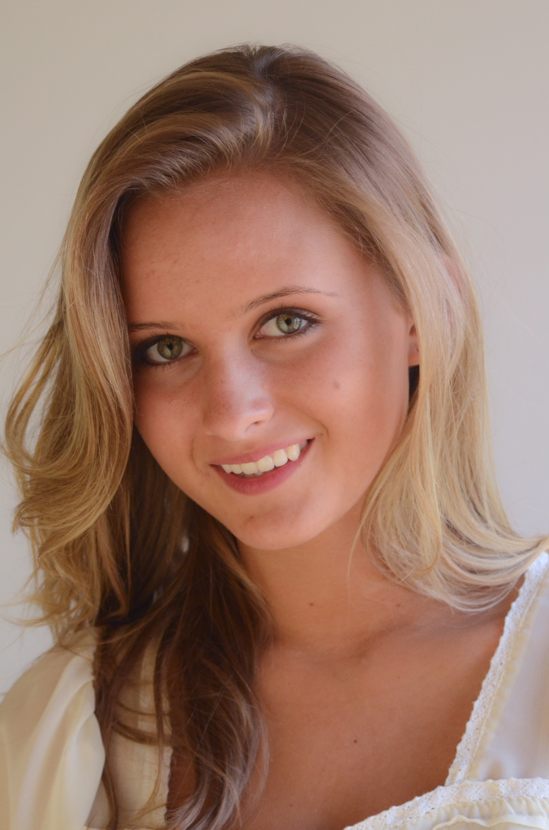

Slide 4
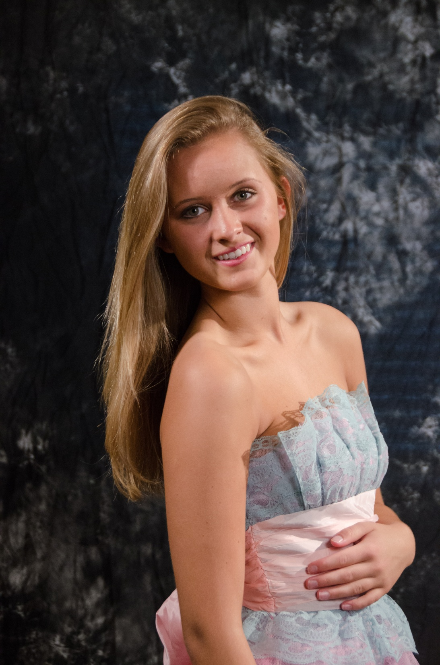

Slide 5
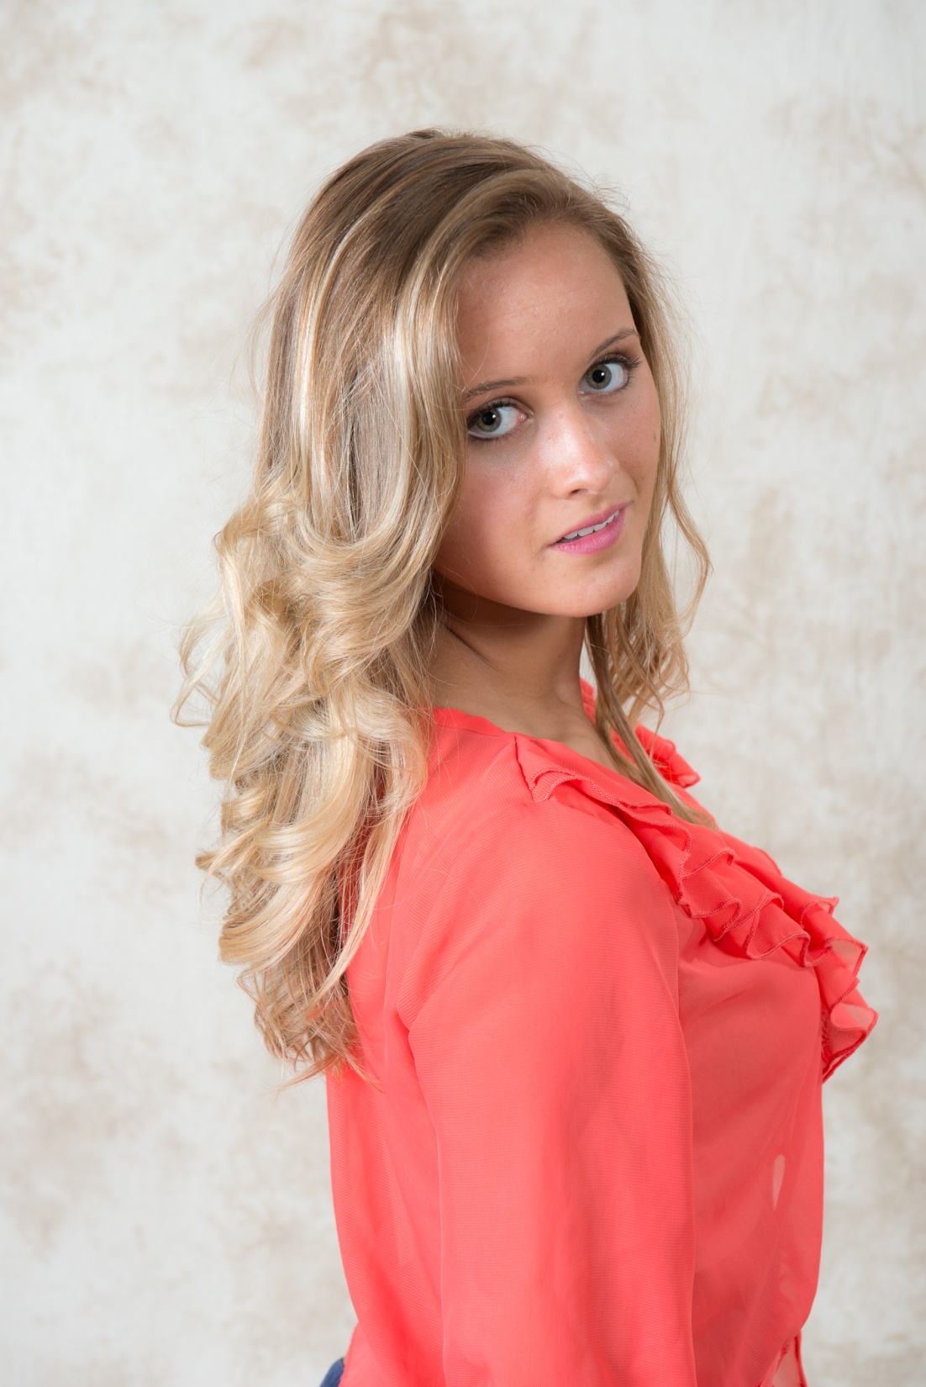

Slide 6
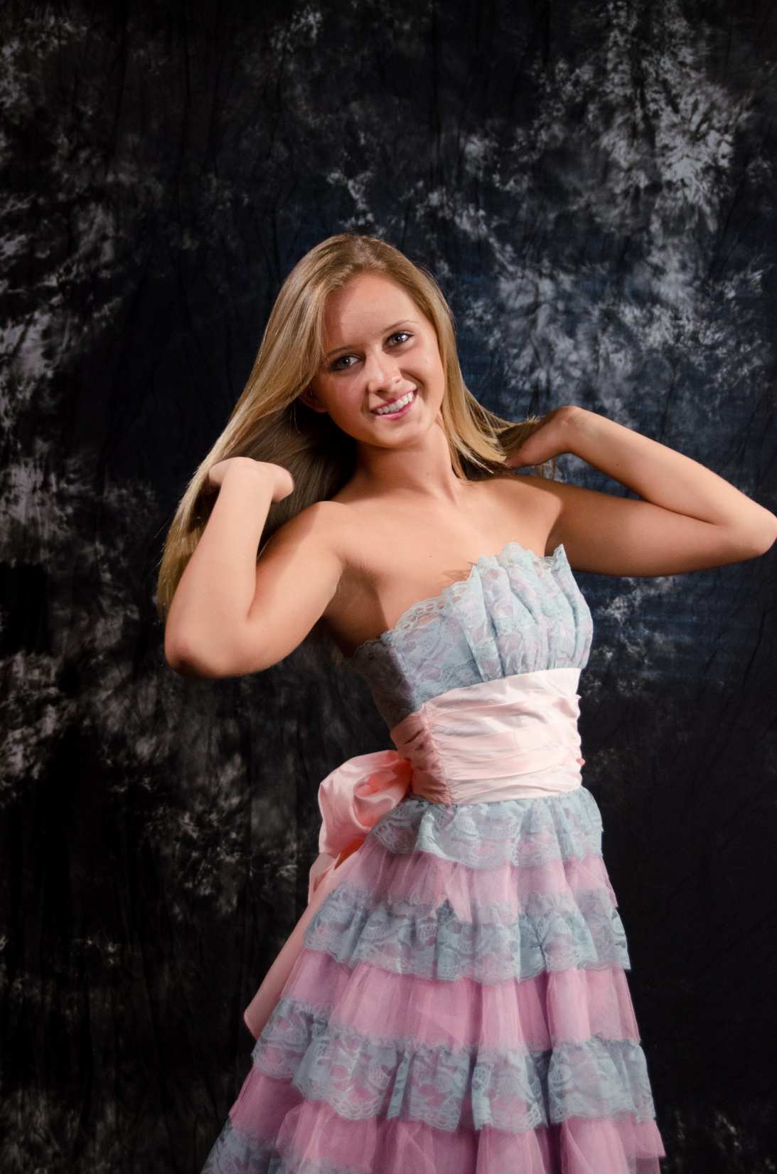

Slide 7
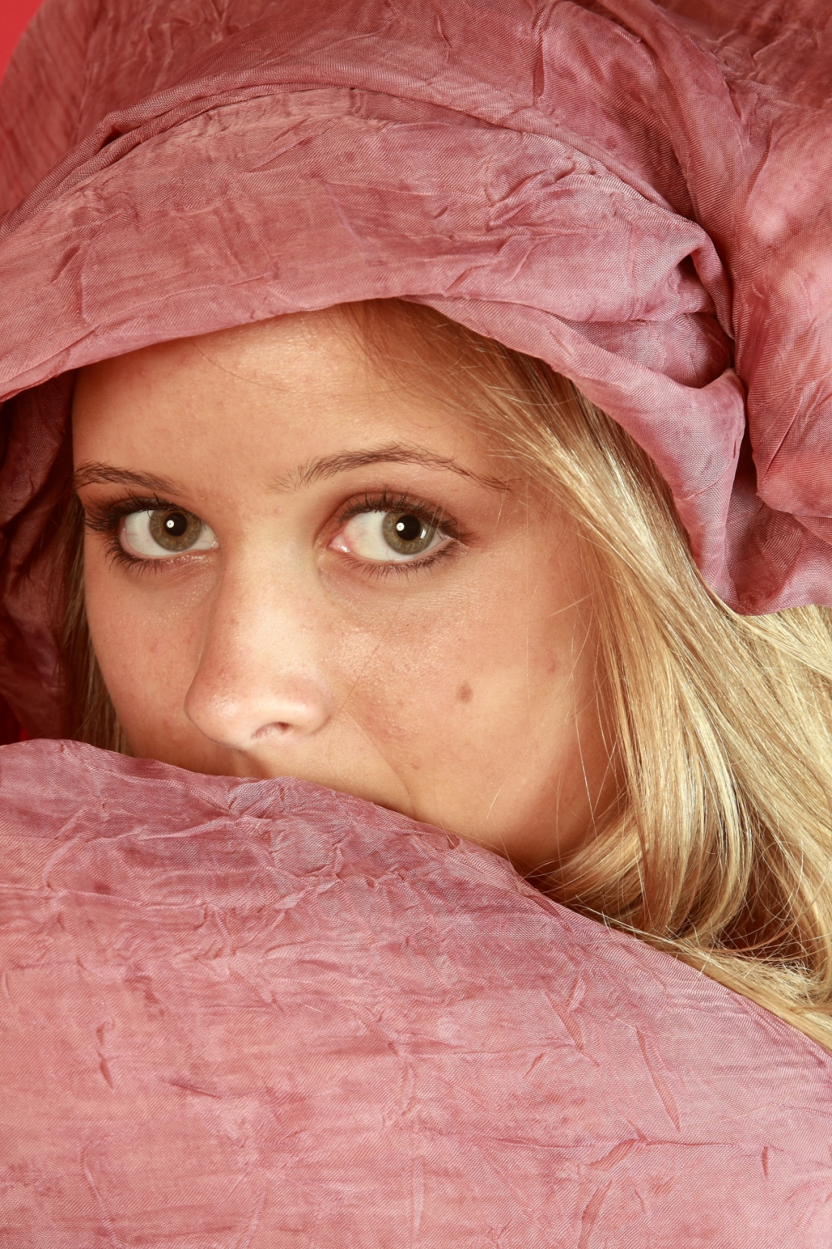

Slide 8
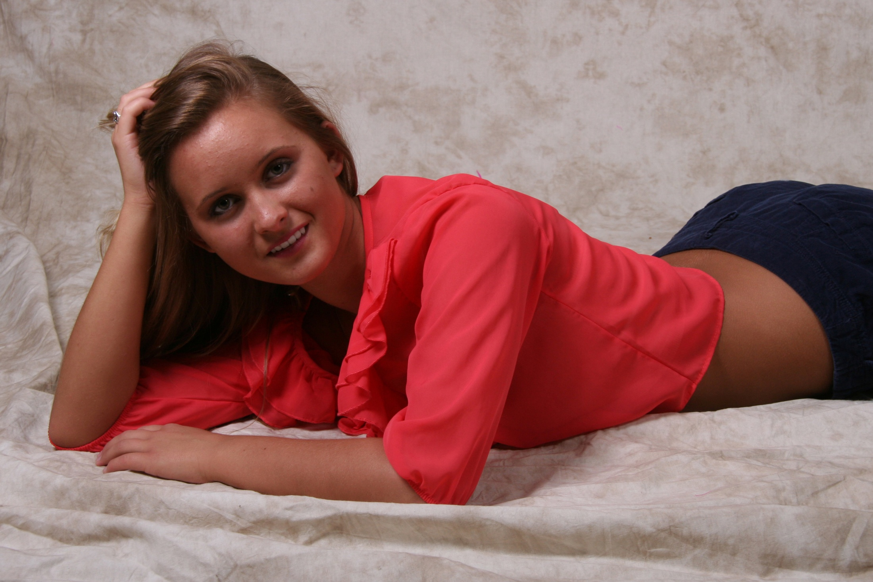

Slide 9
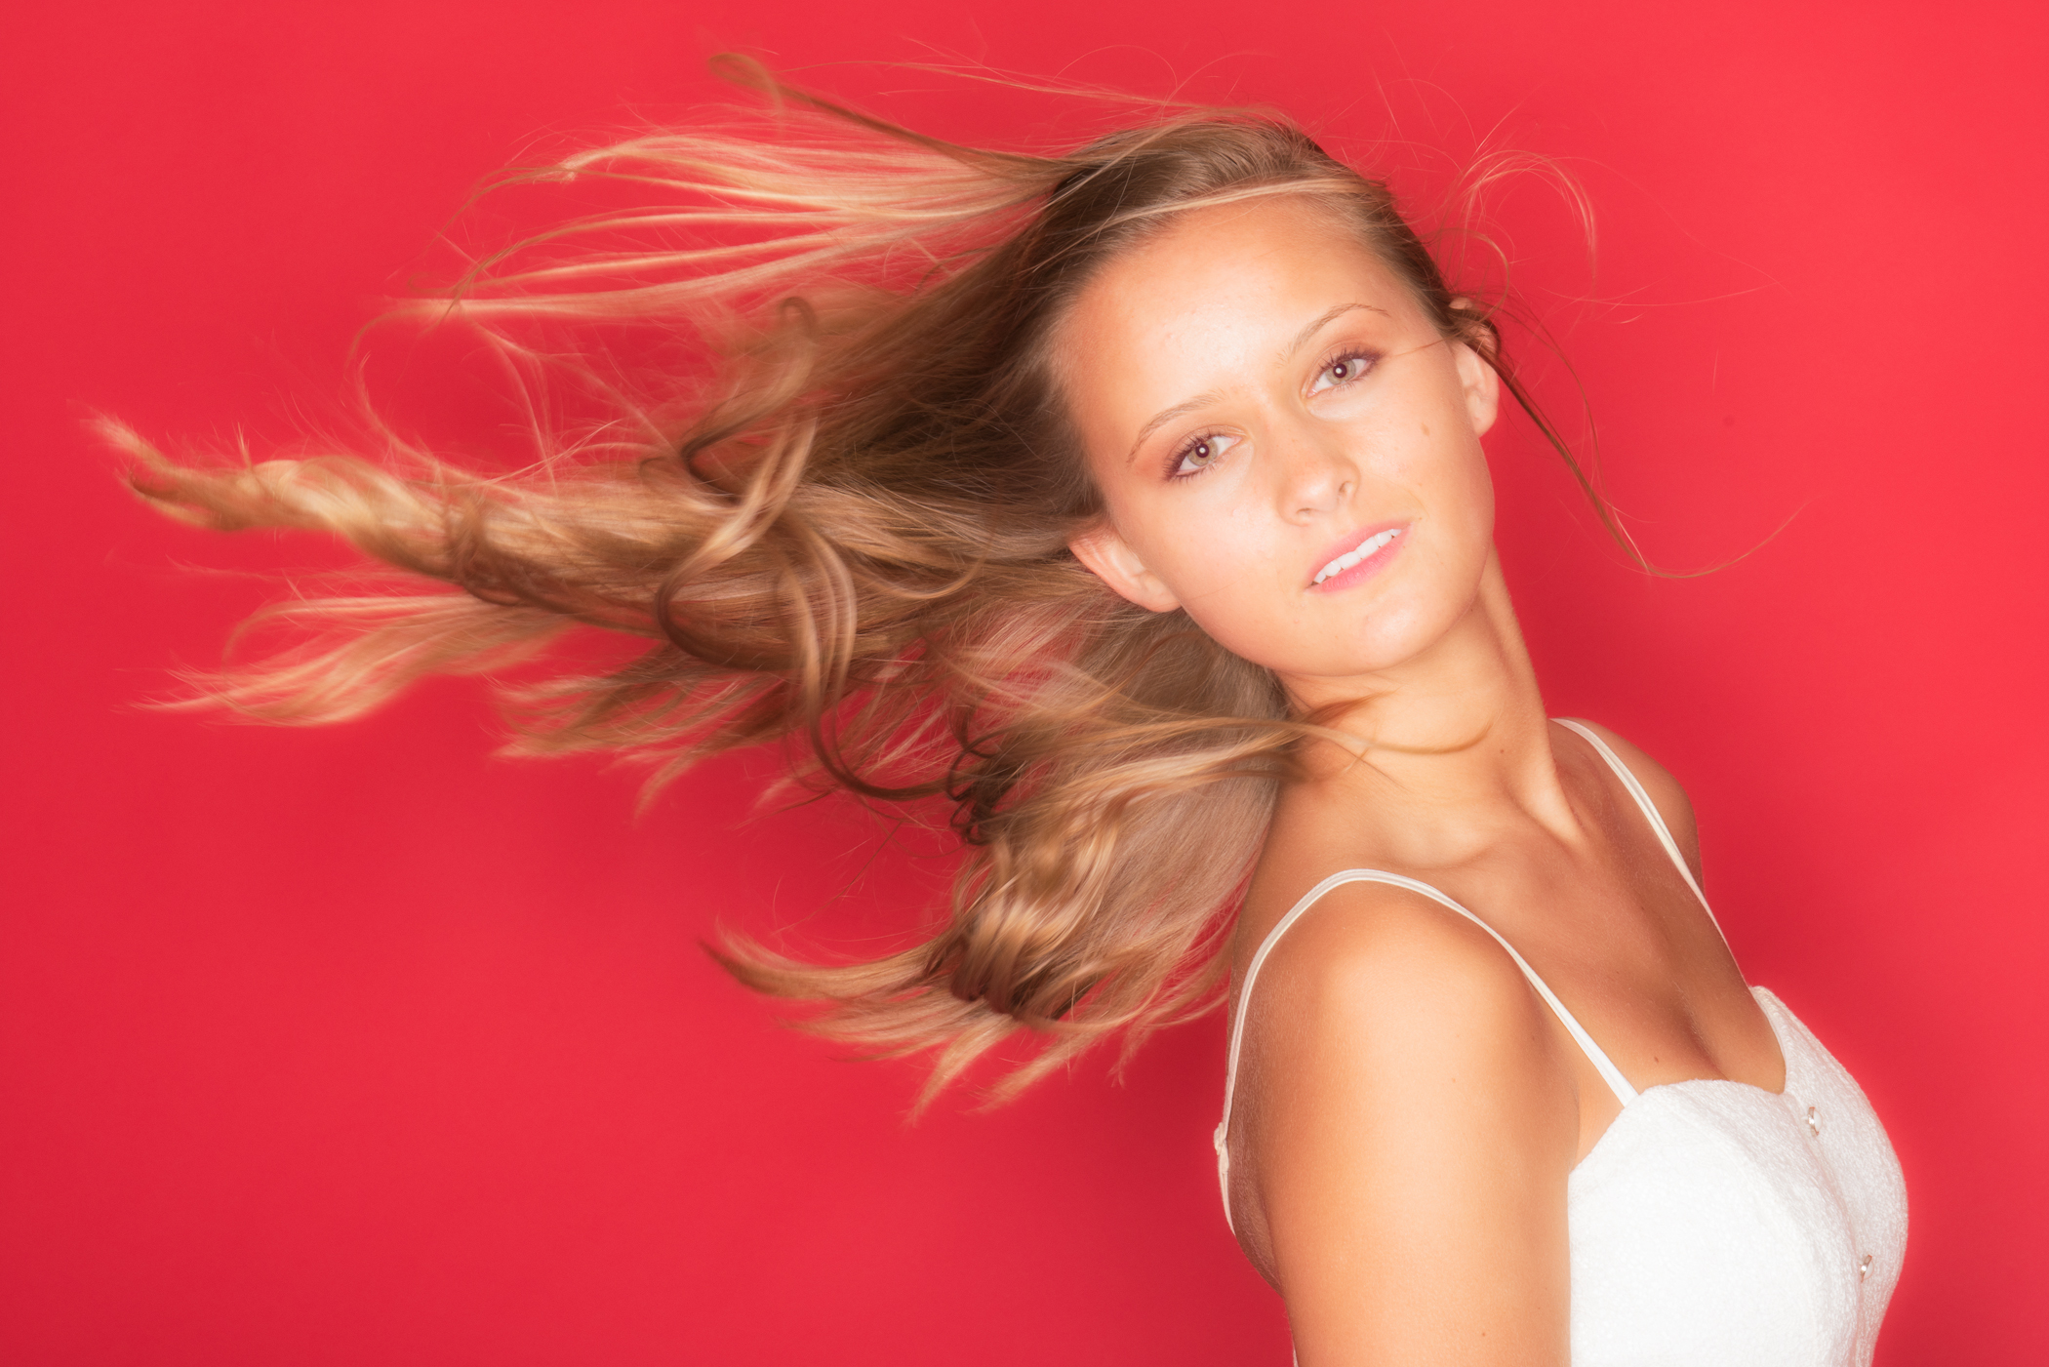

Slide 10
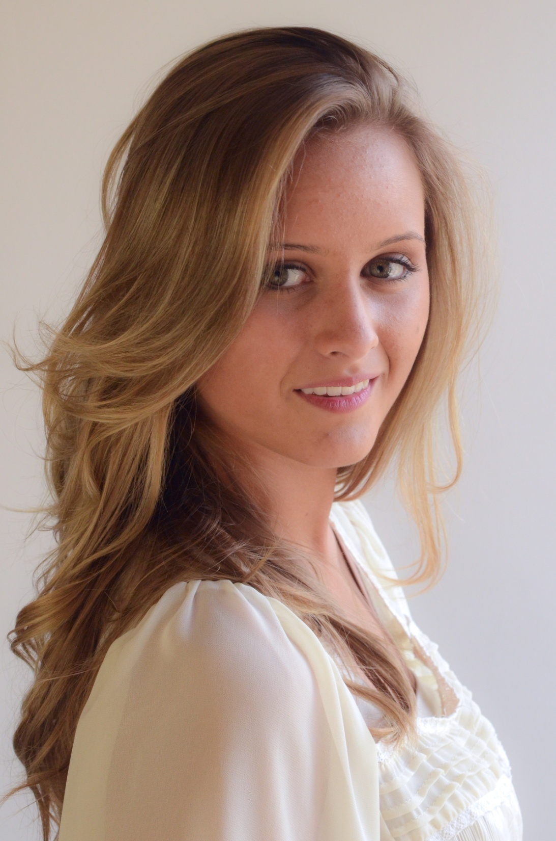

Slide 11
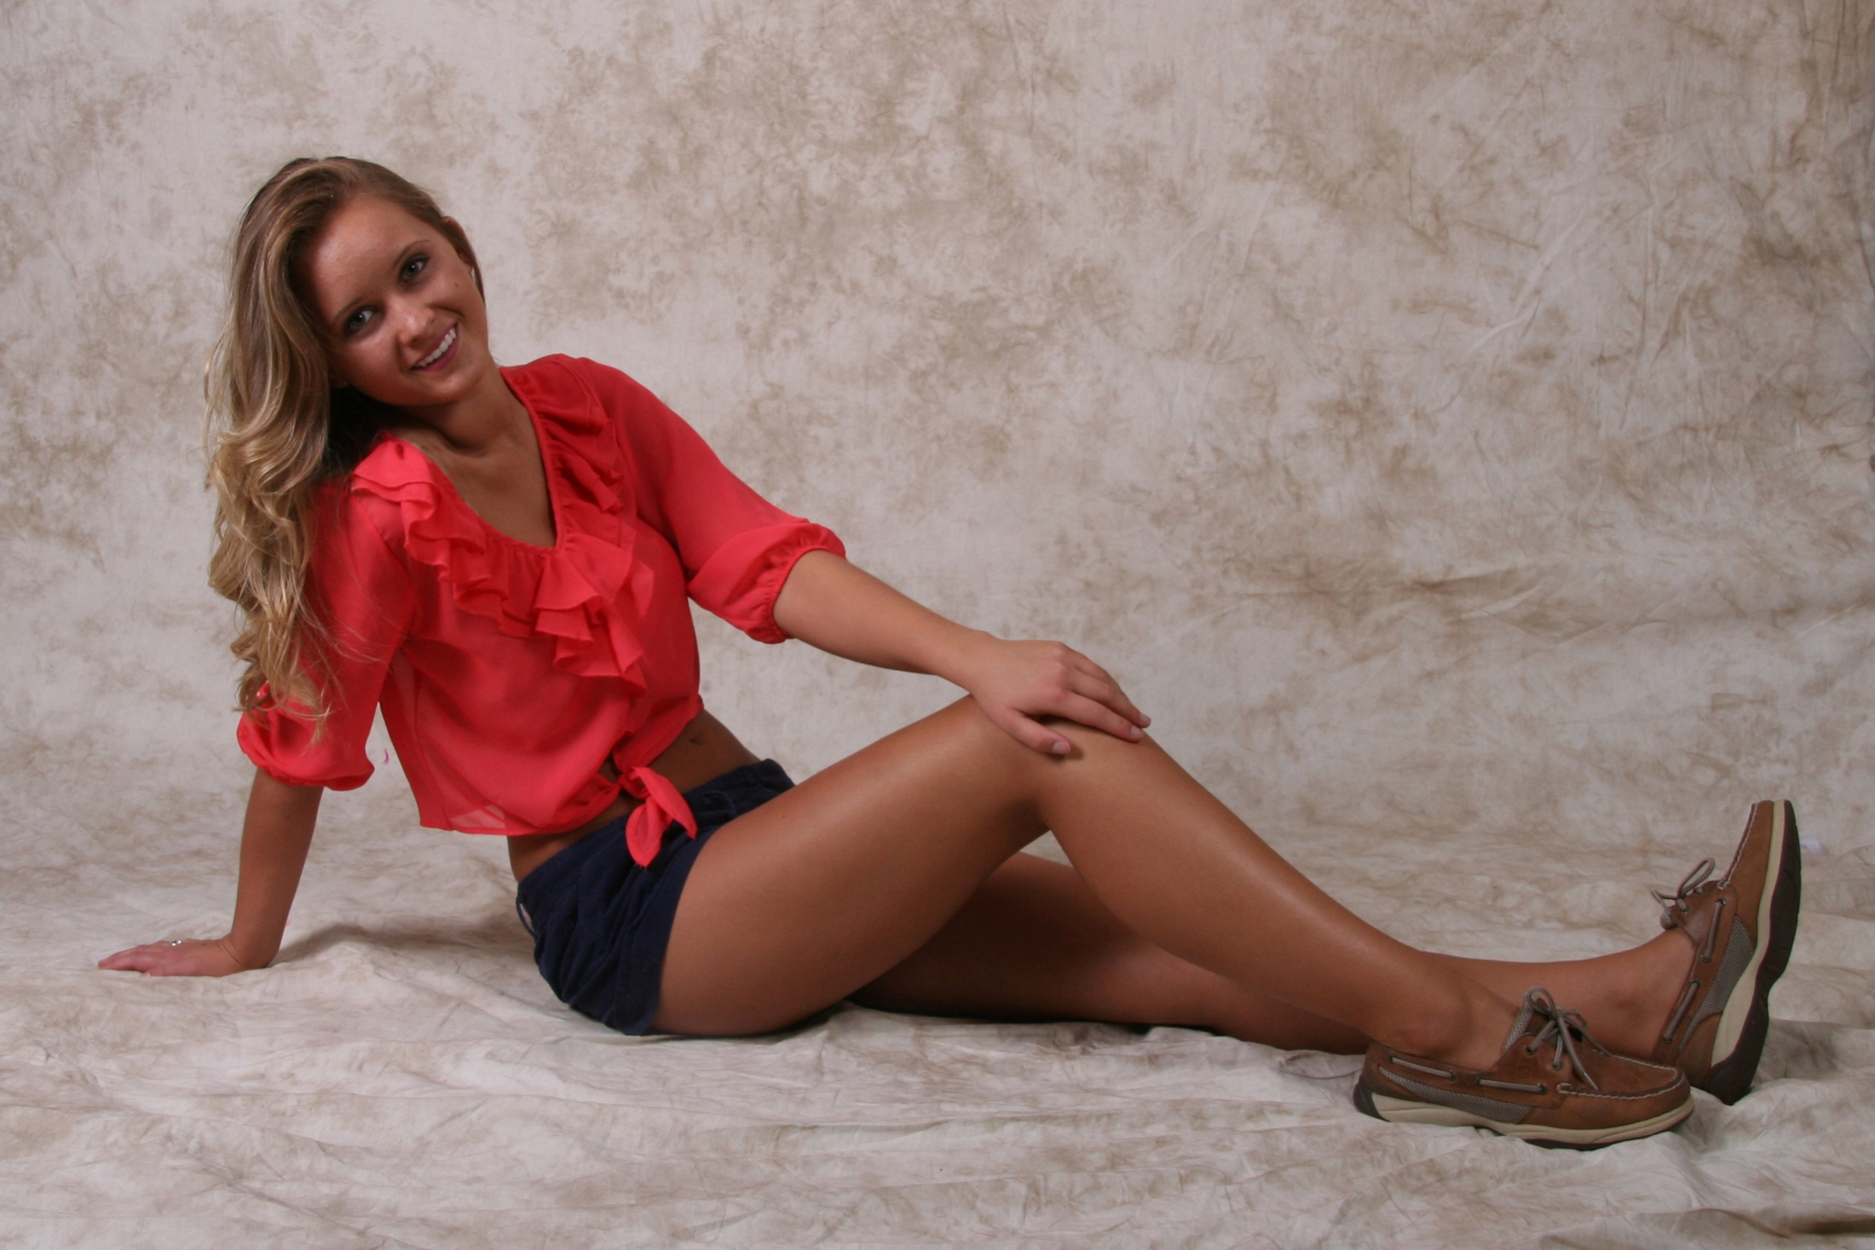

Slide 12
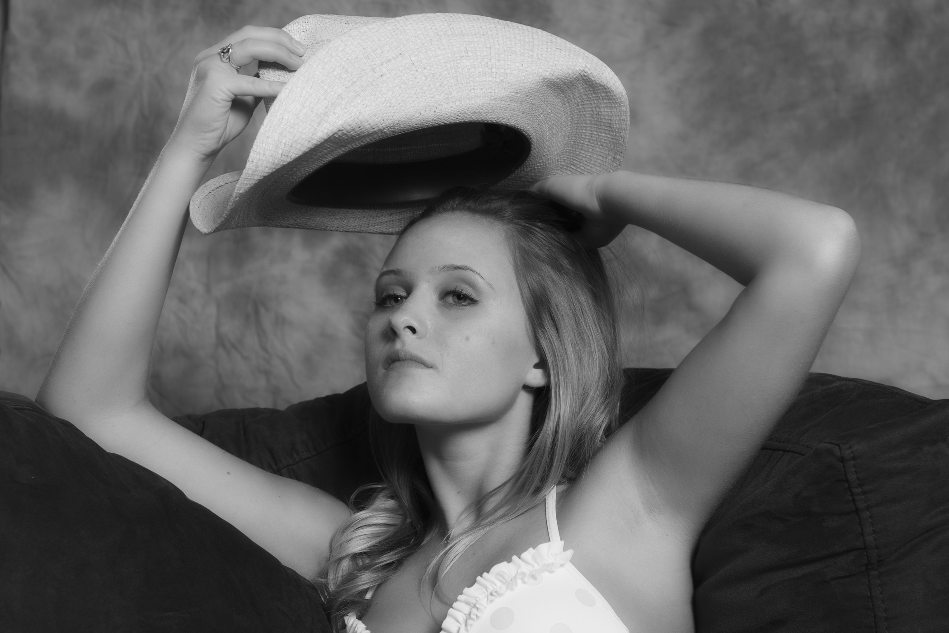

Slide 13
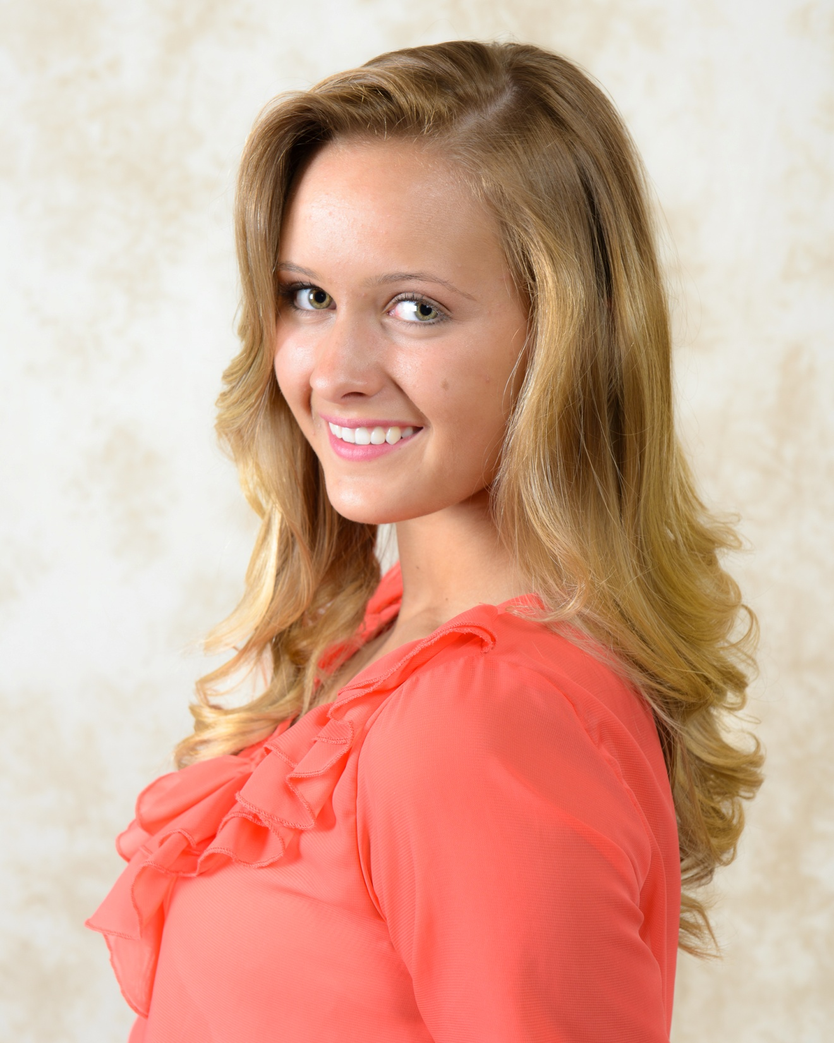

Slide 14
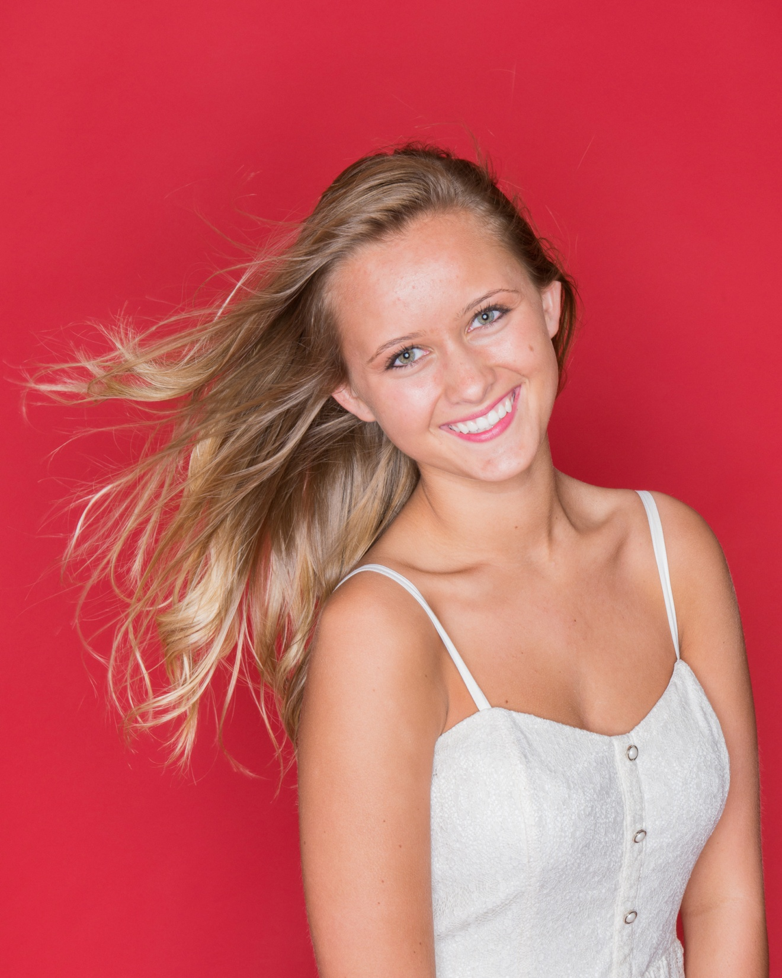

Slide 15
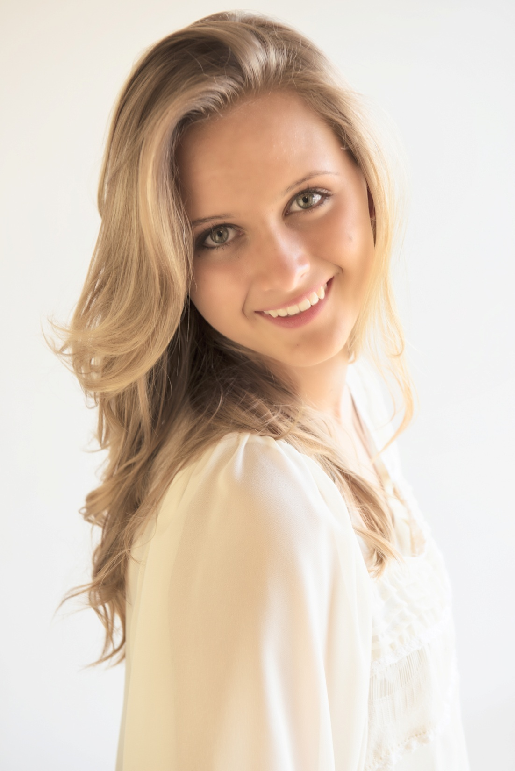

Slide 16
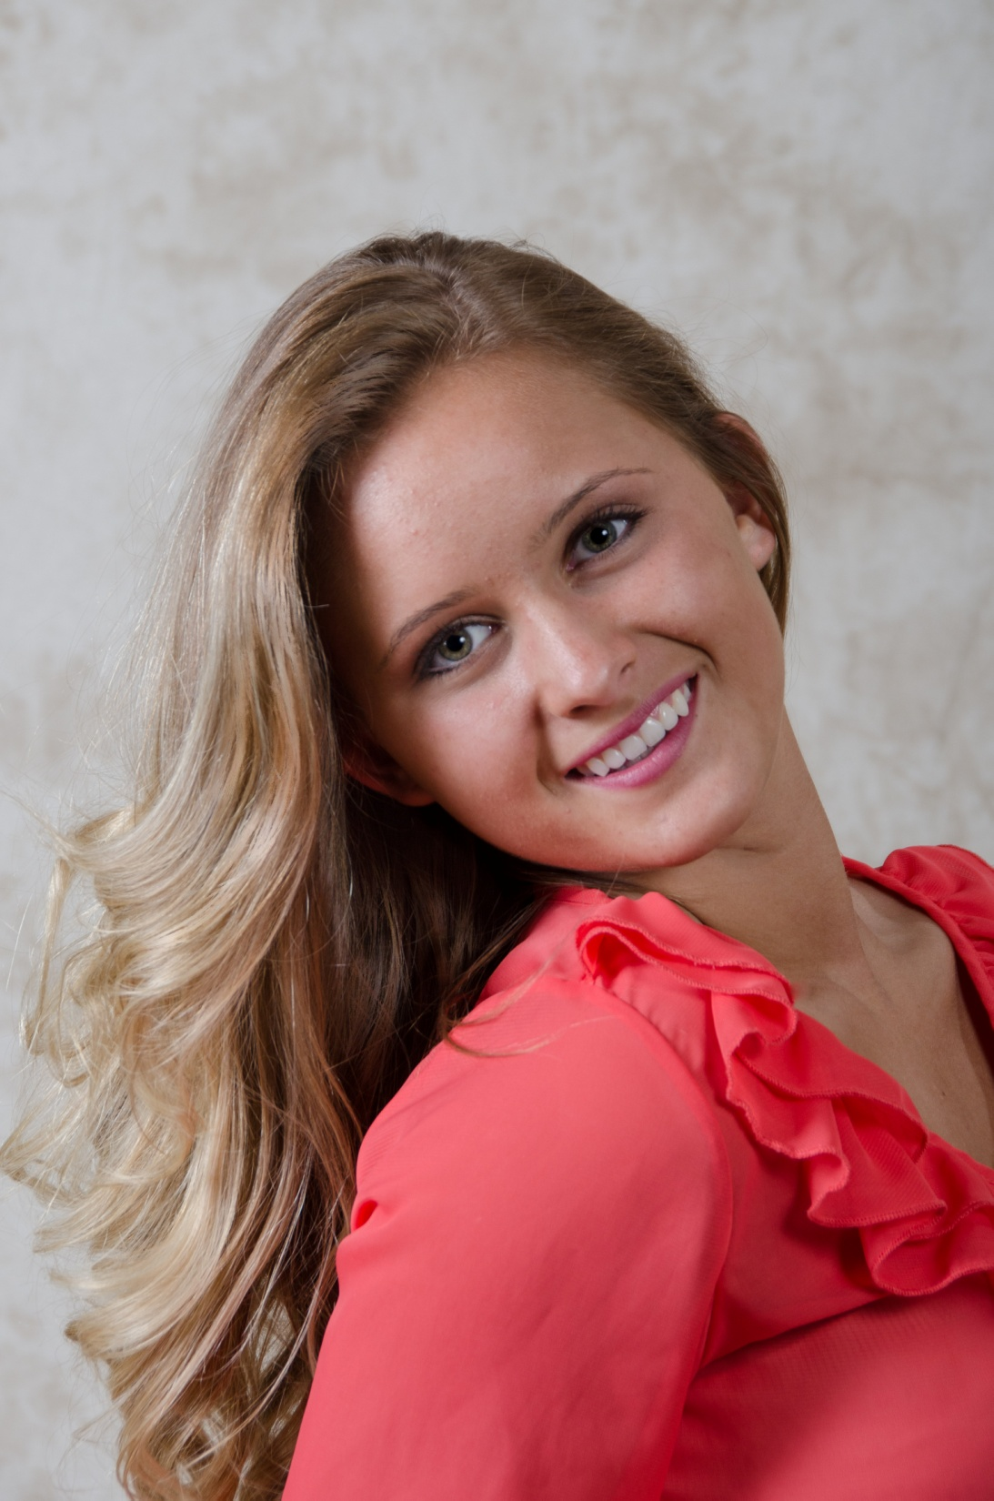

Slide 17
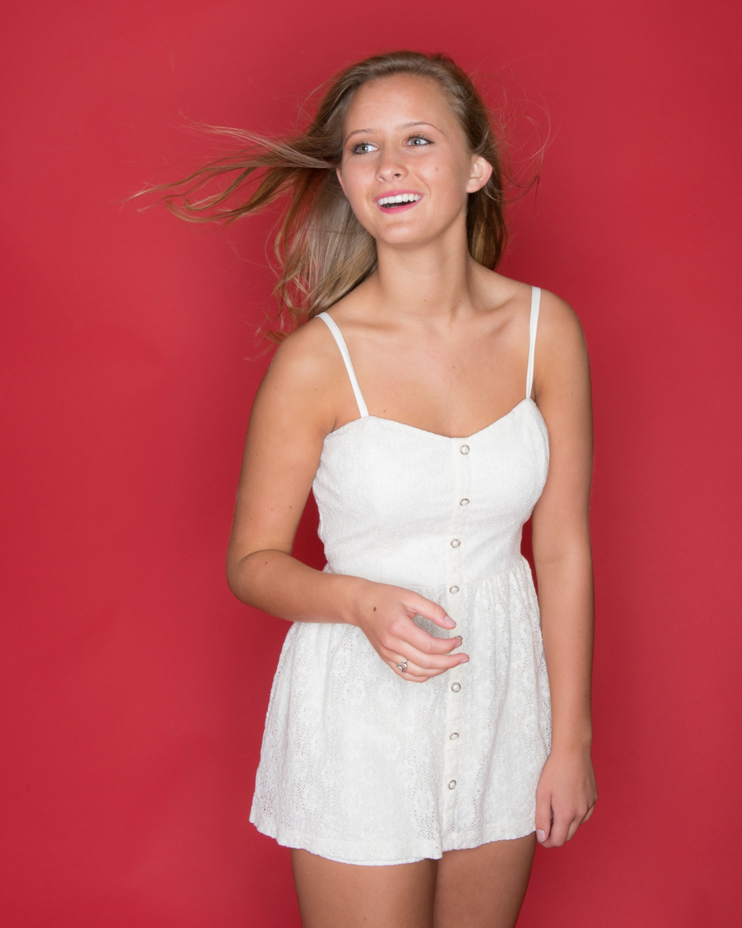

Slide 18
Ciara S.
(1st PPC shoot)
Freelance Model

Slide 19
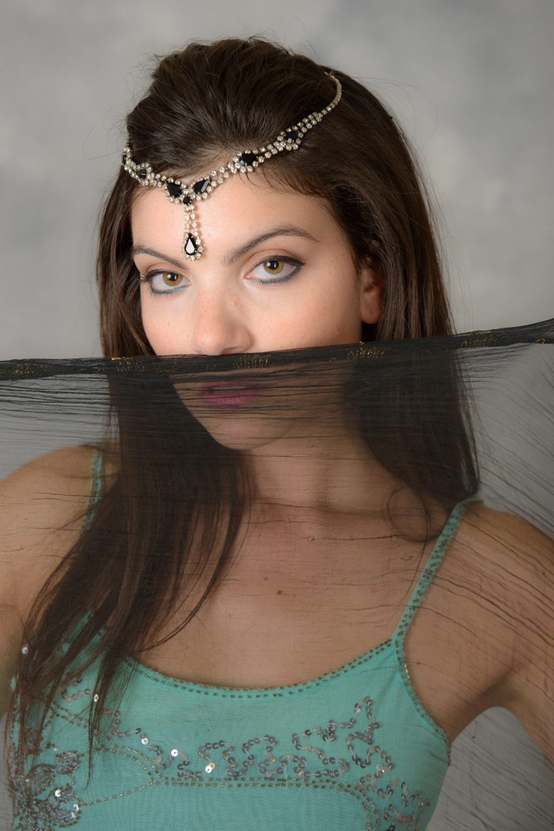

Slide 20
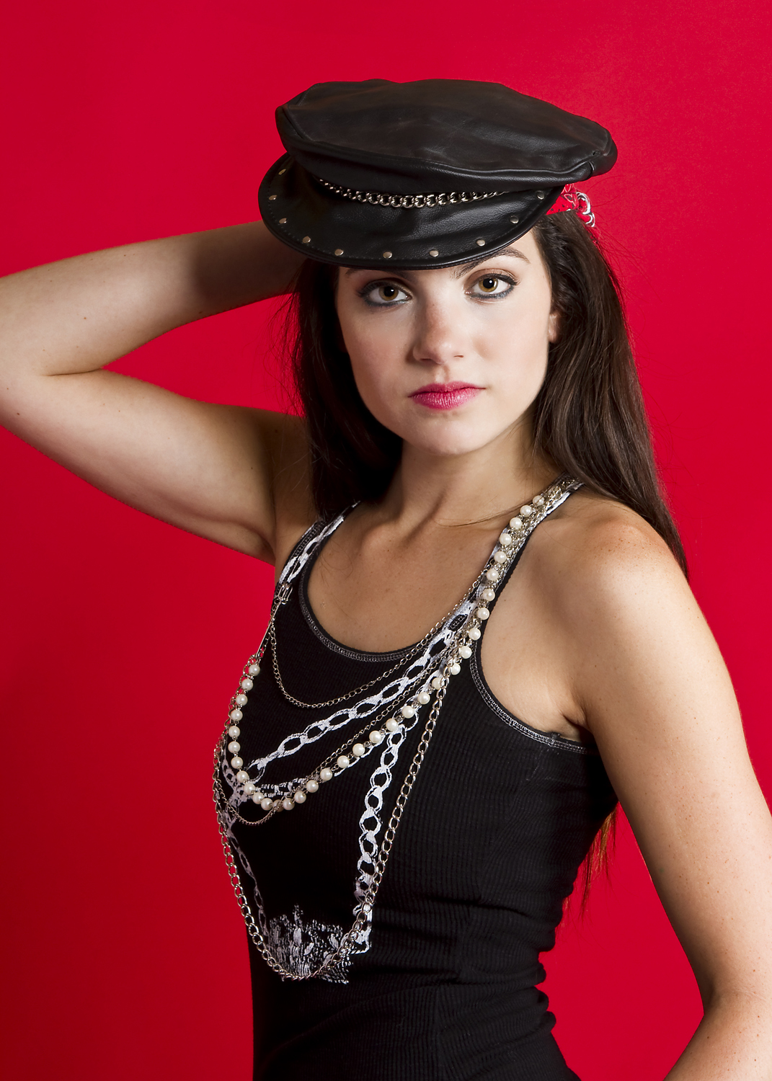

Slide 21
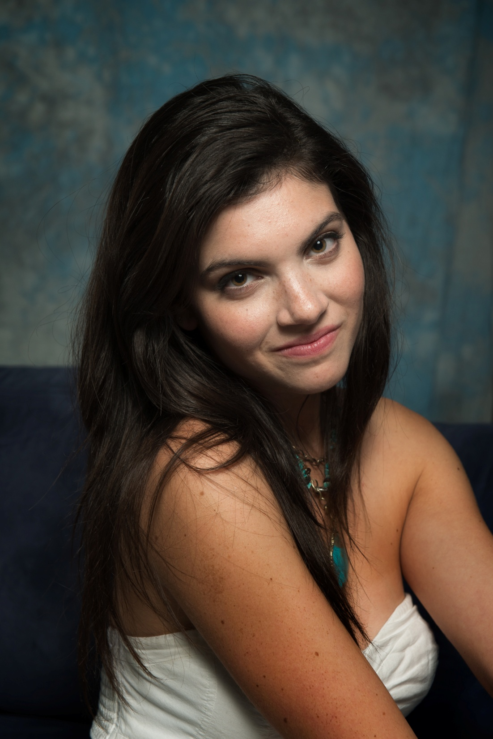

Slide 22
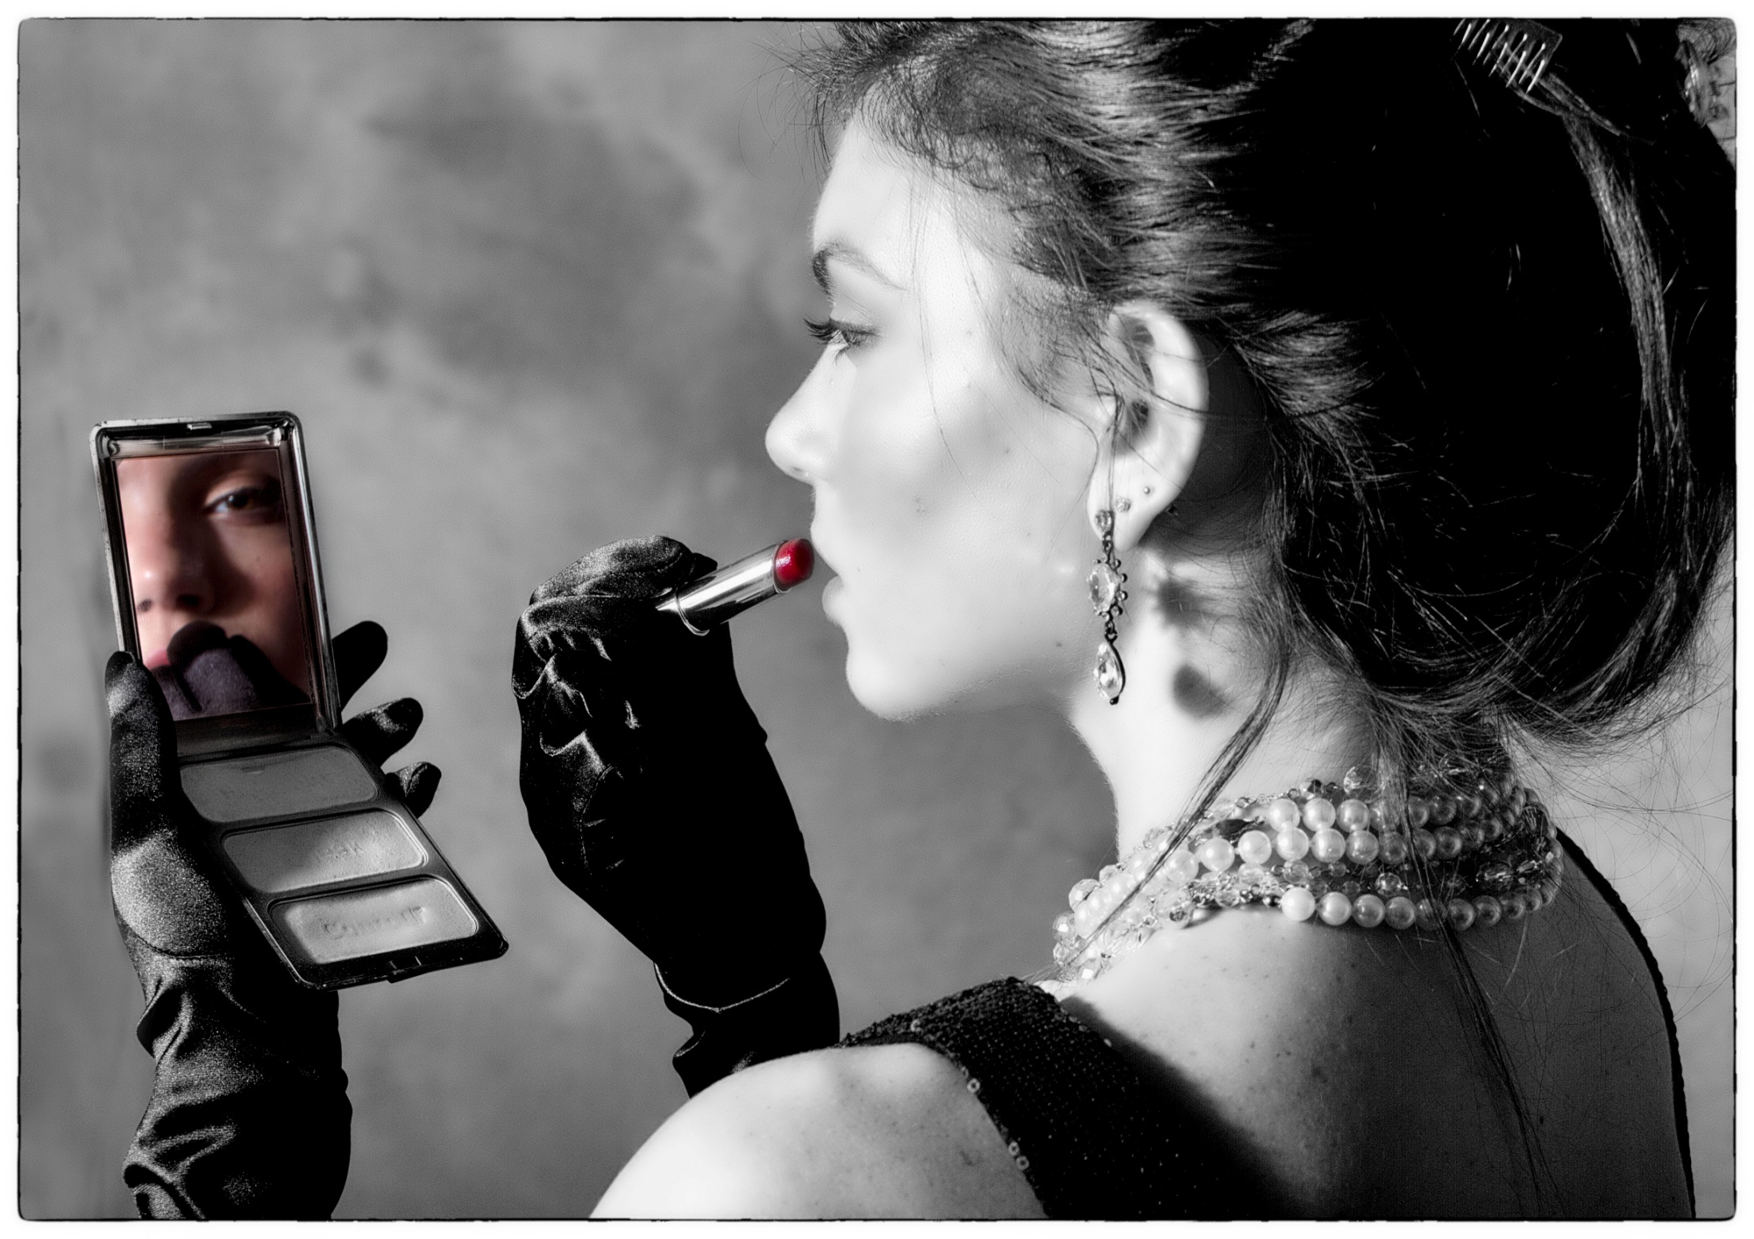

Slide 23
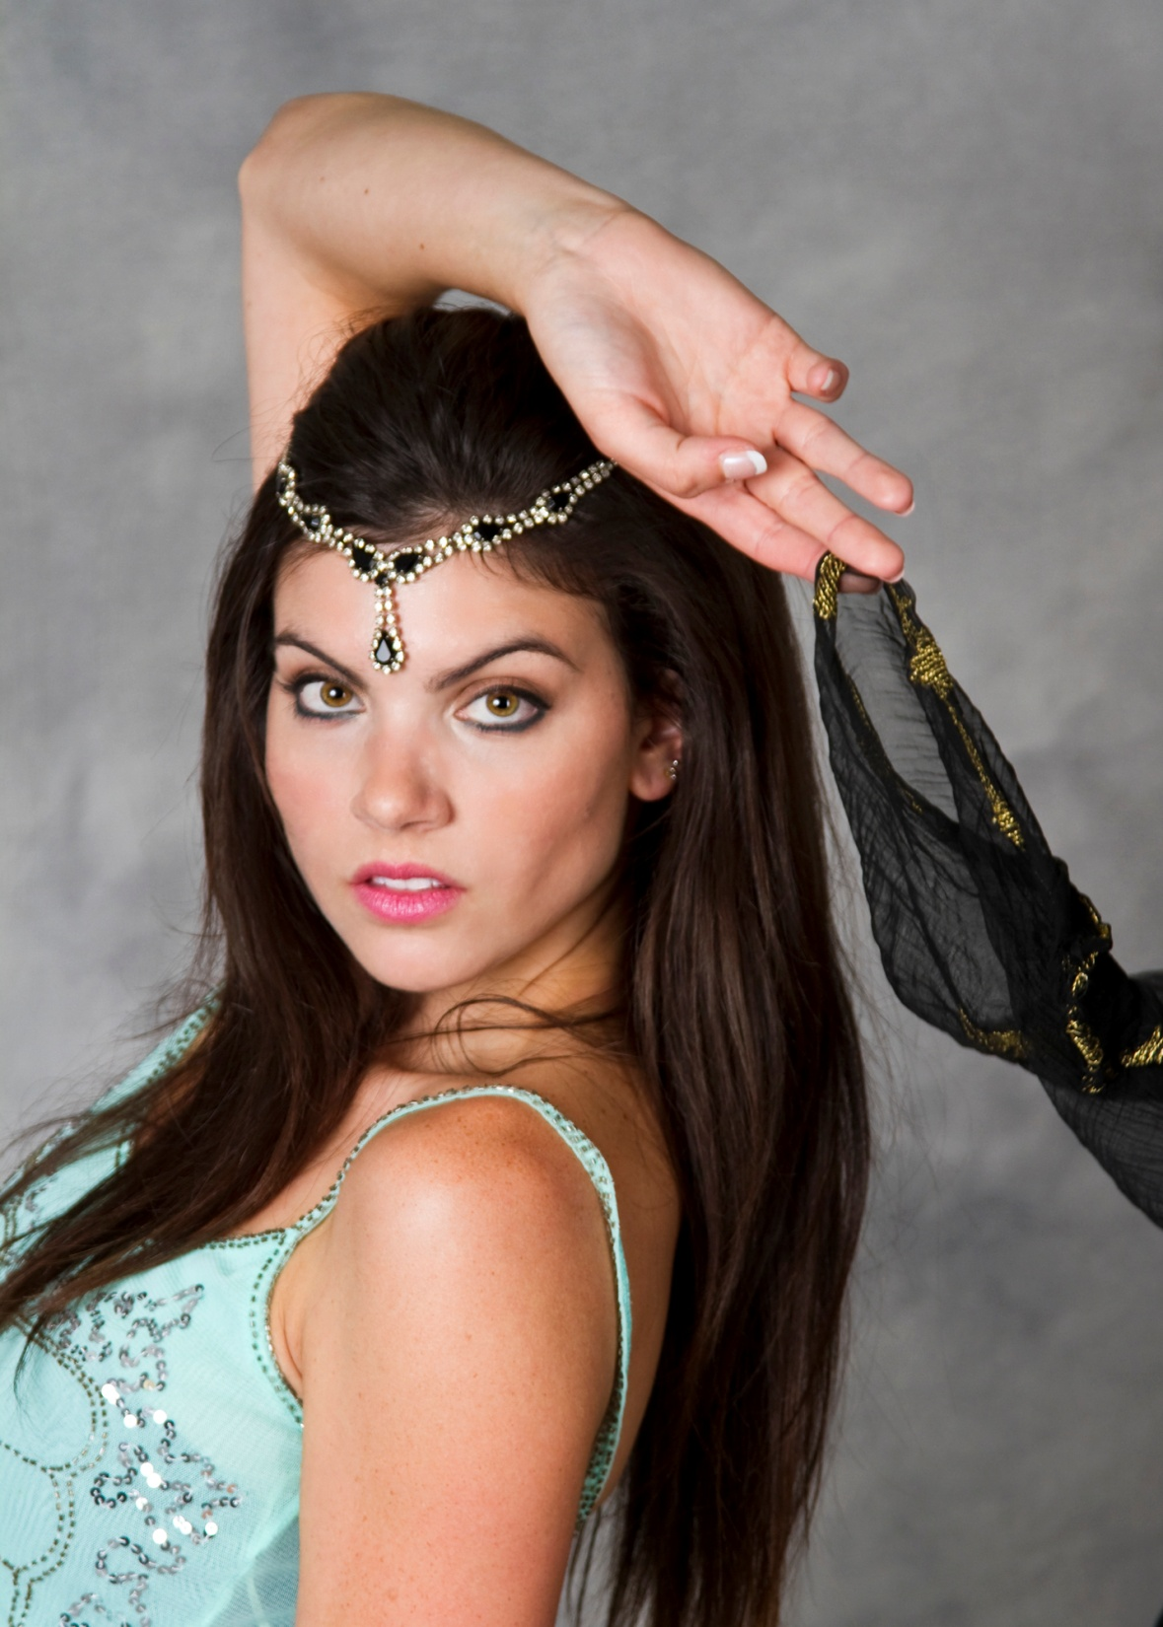

Slide 24
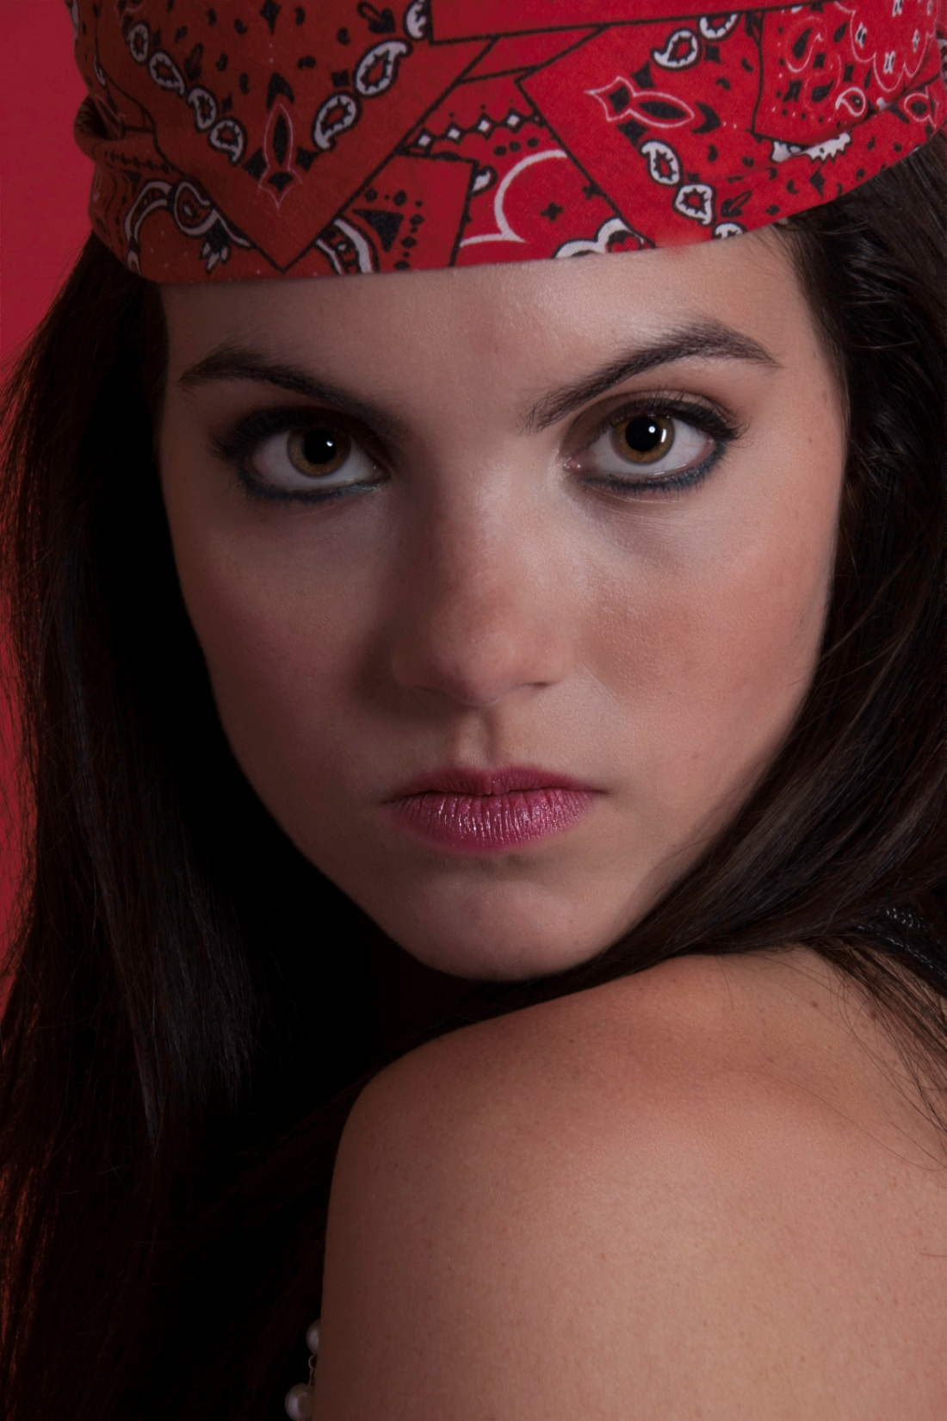

Slide 25
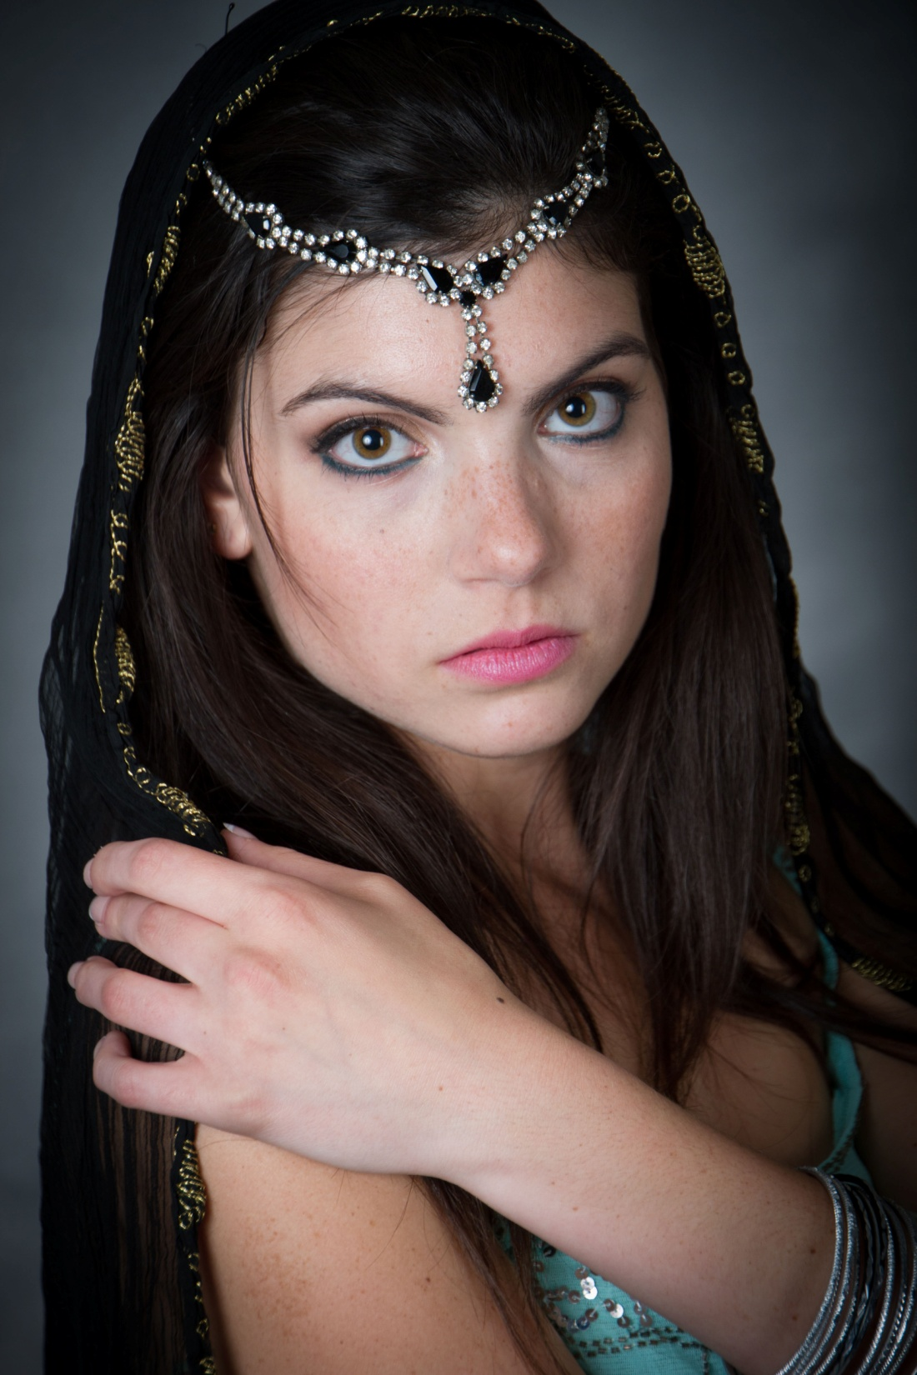

Slide 26
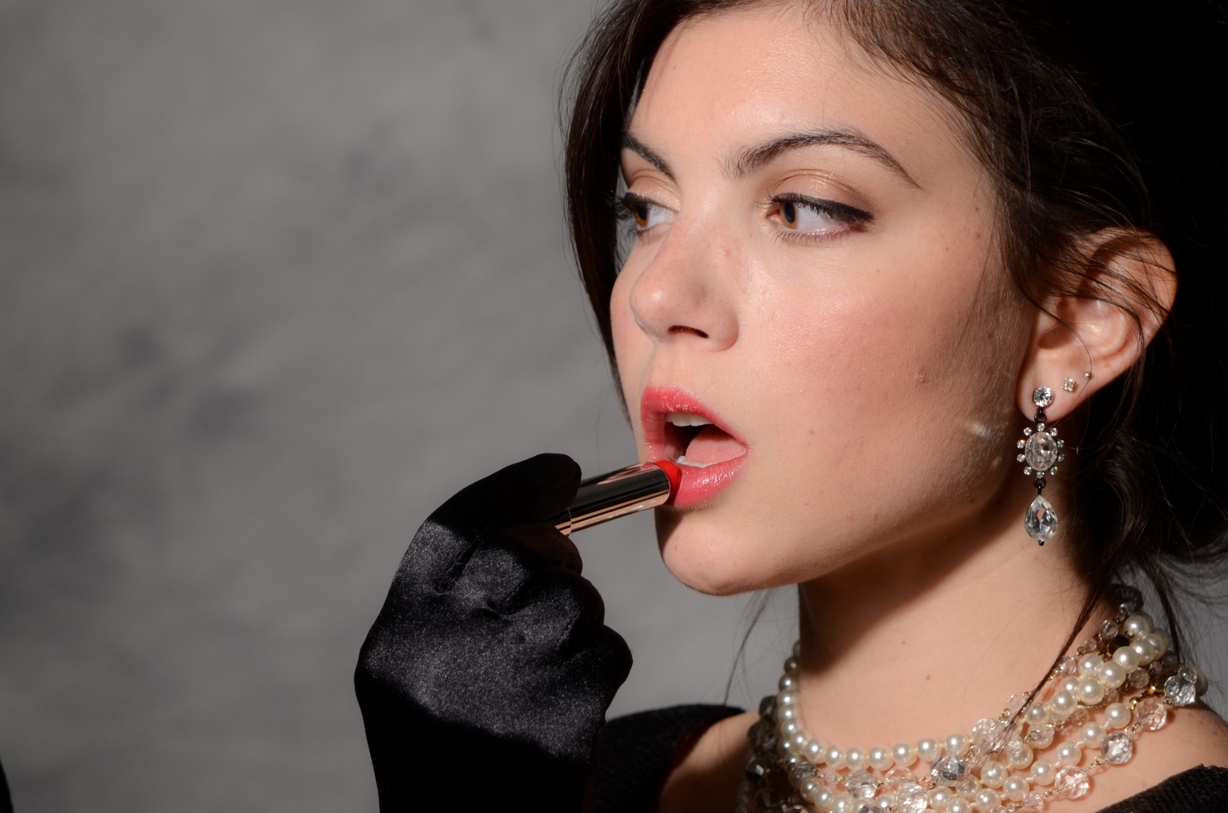

Slide 27
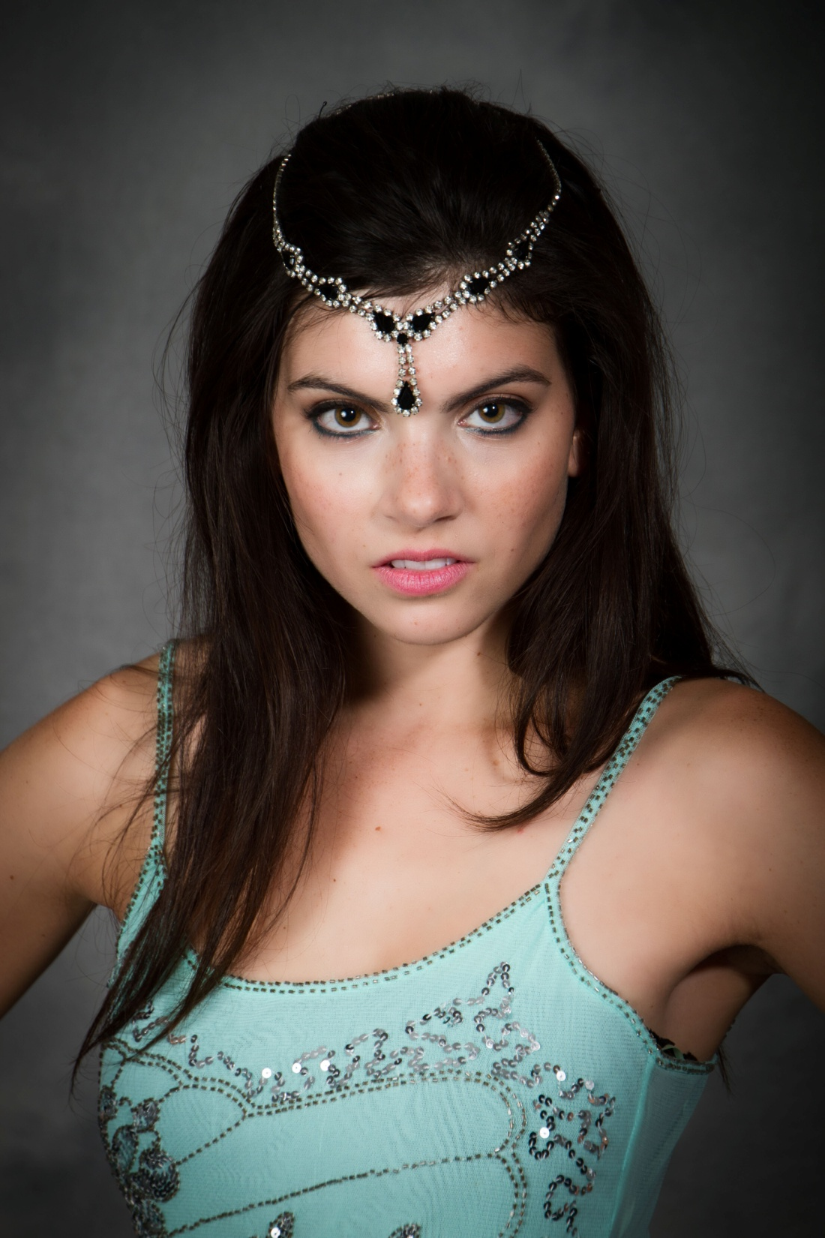

Slide 28
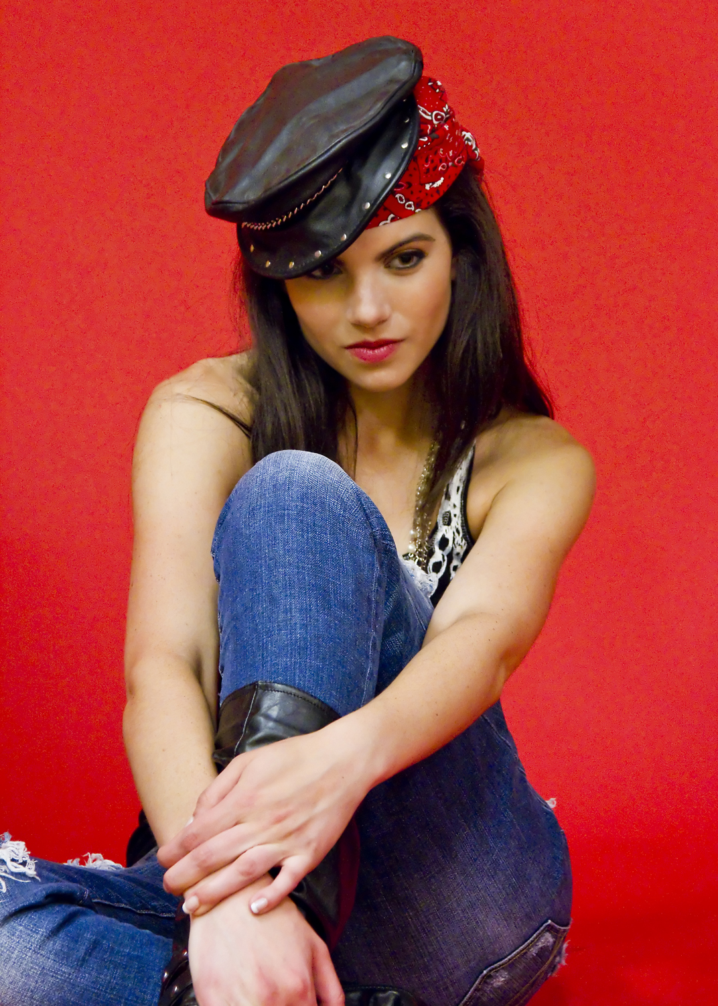

Slide 29
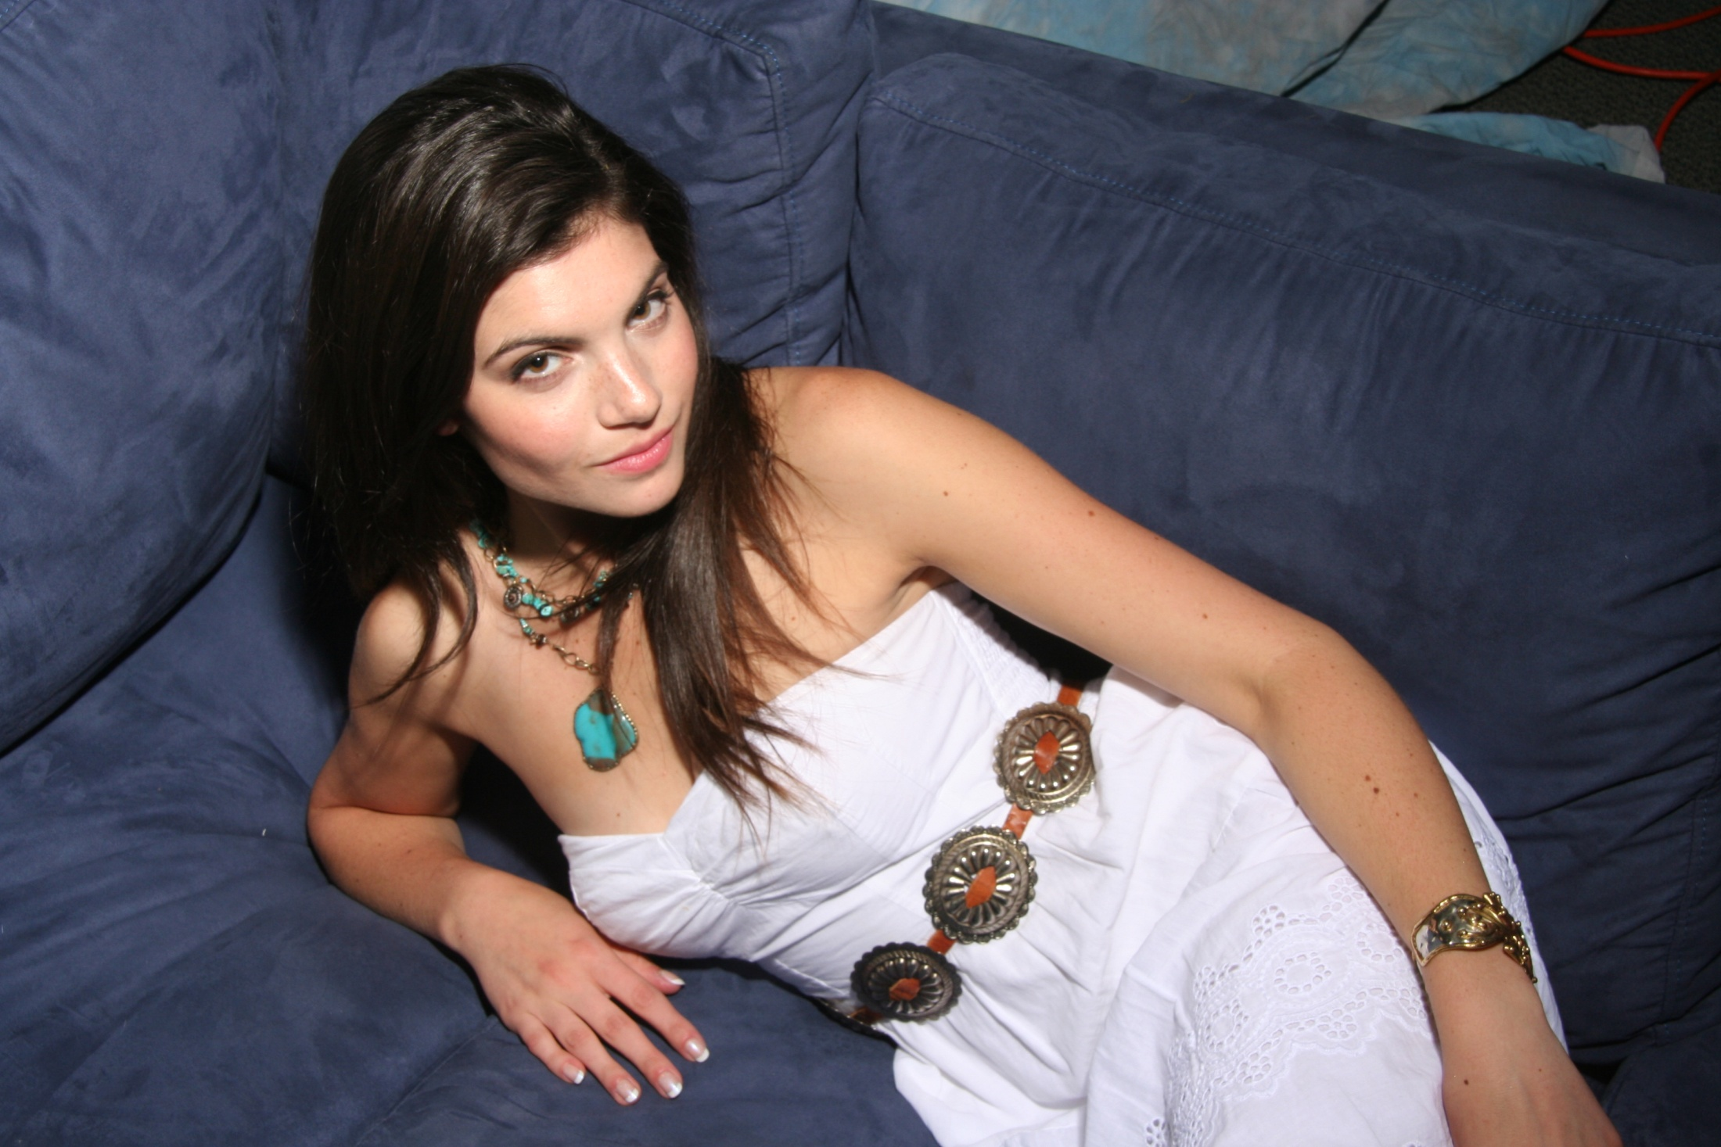

Slide 30
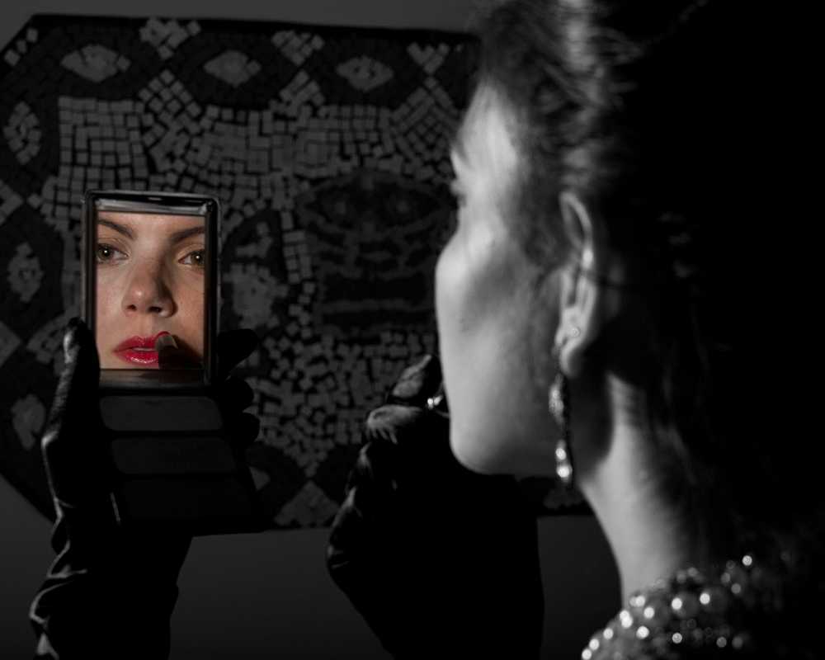

Slide 31
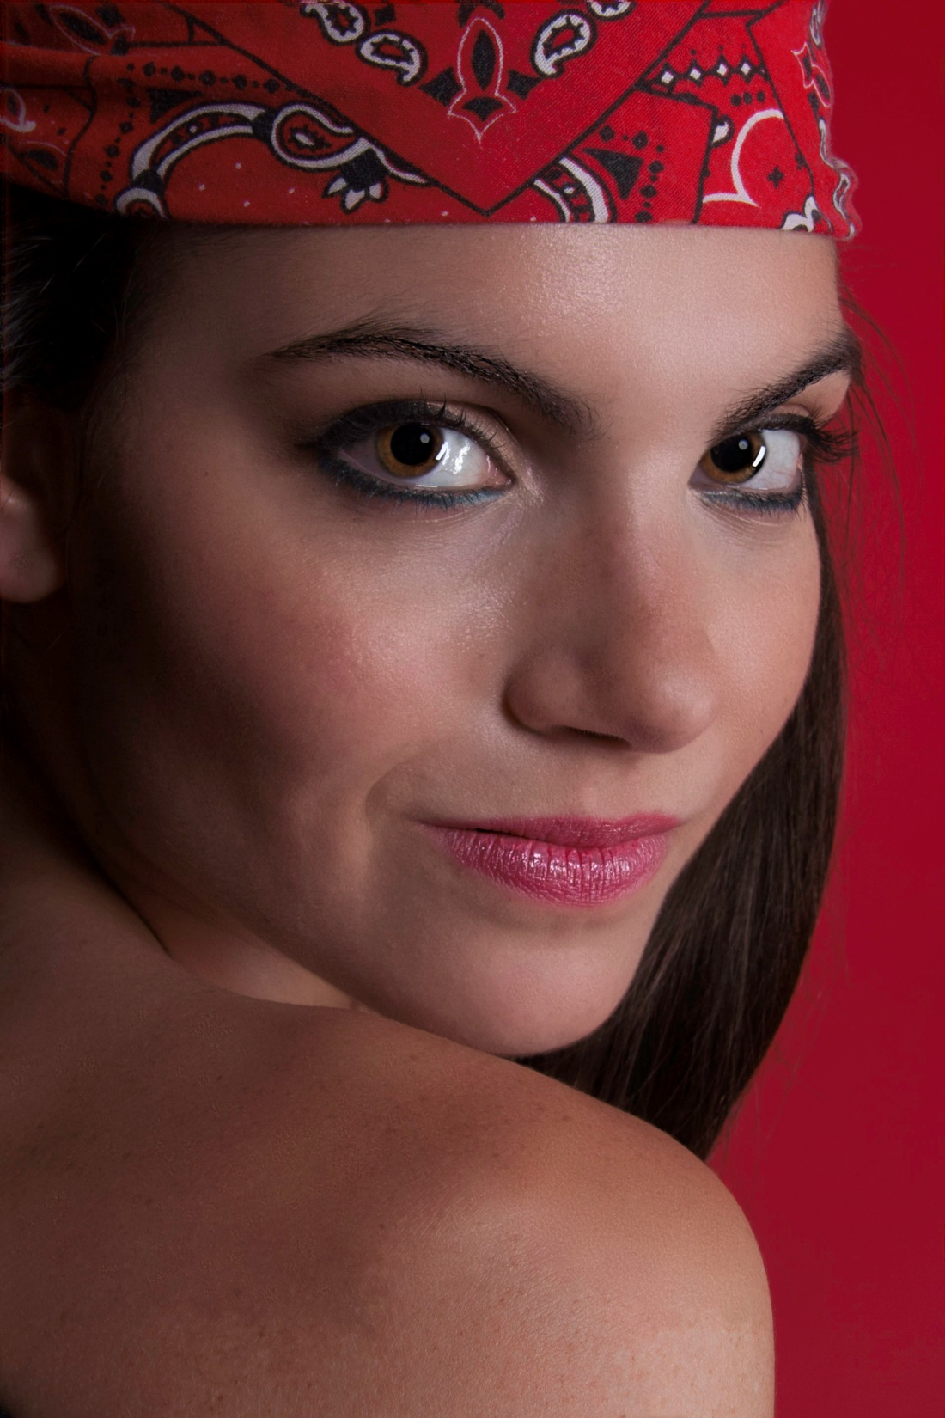

Slide 32
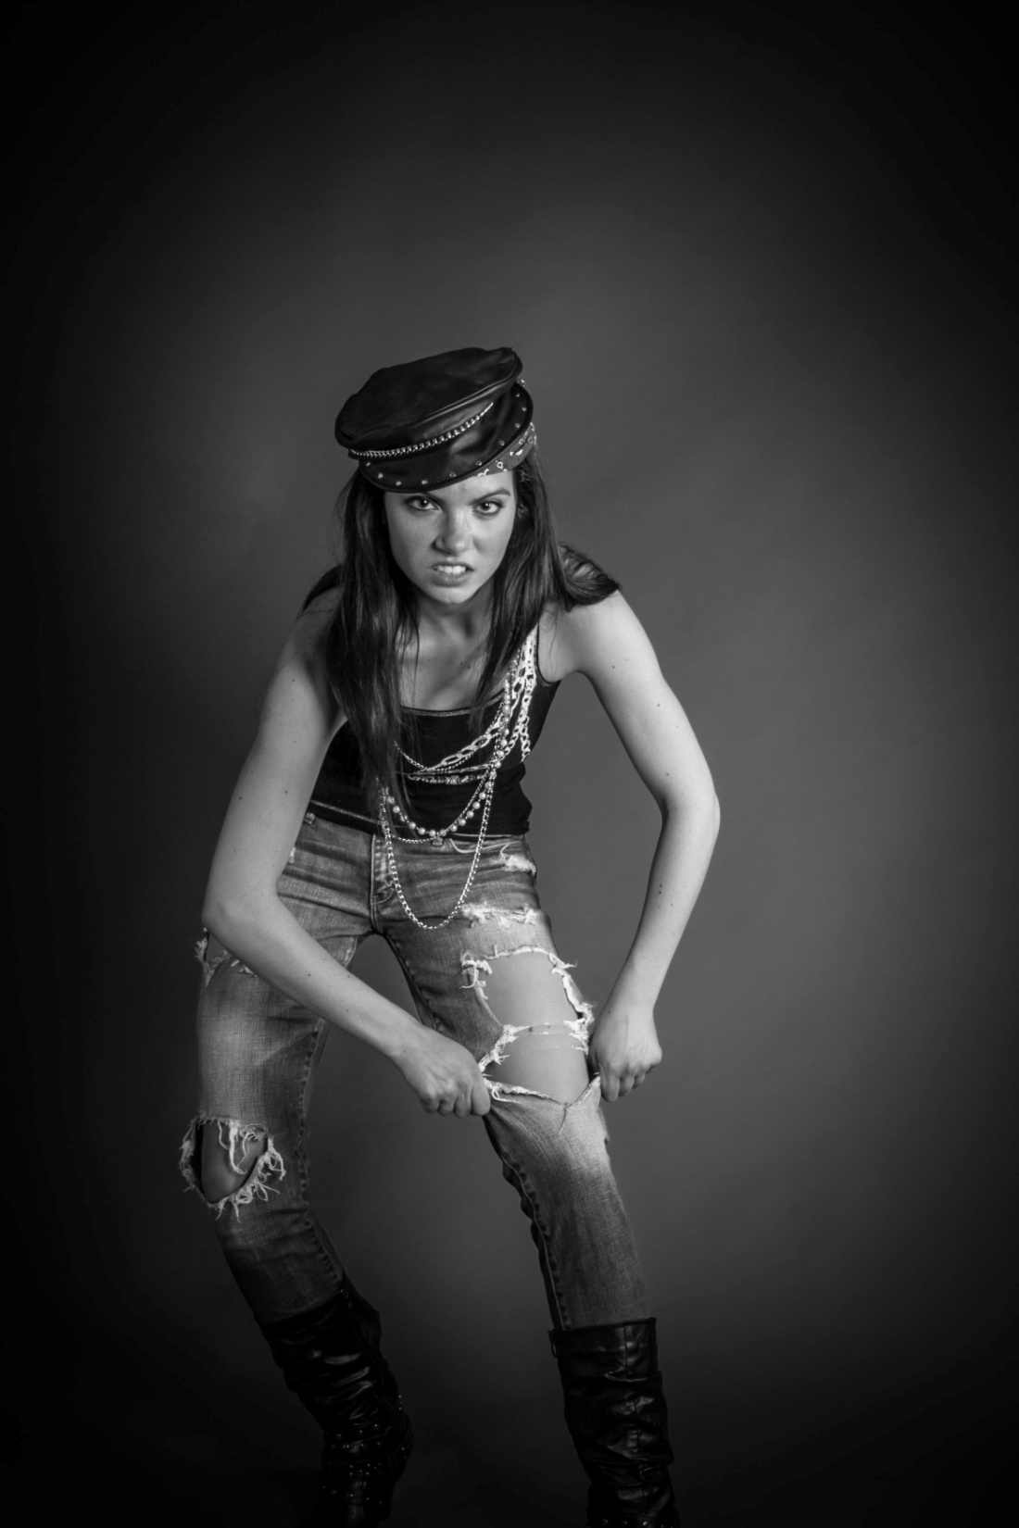

Slide 33
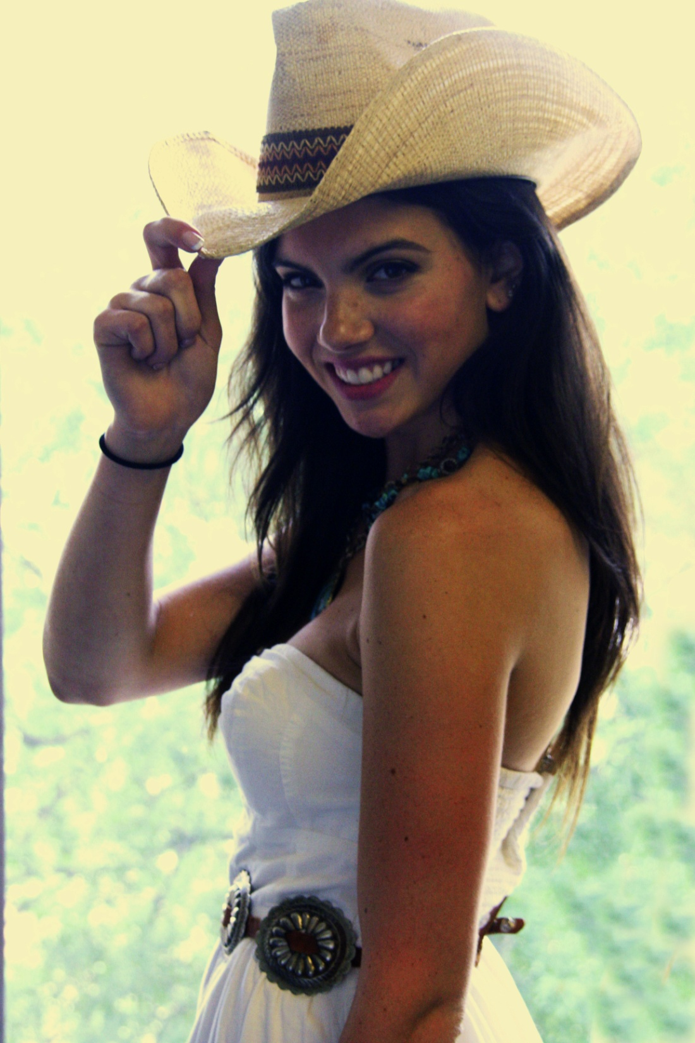

Slide 34
Sarah A.
(1st PPC shoot)
CORE Talent Agency
www.CoreTalent.biz

Slide 35
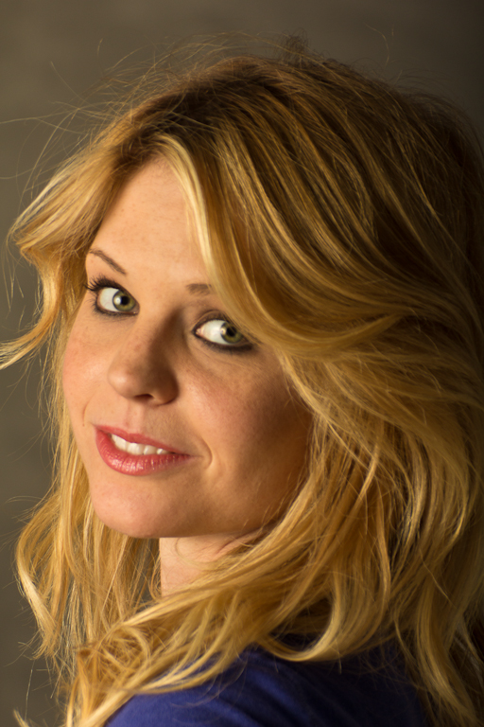

Slide 36
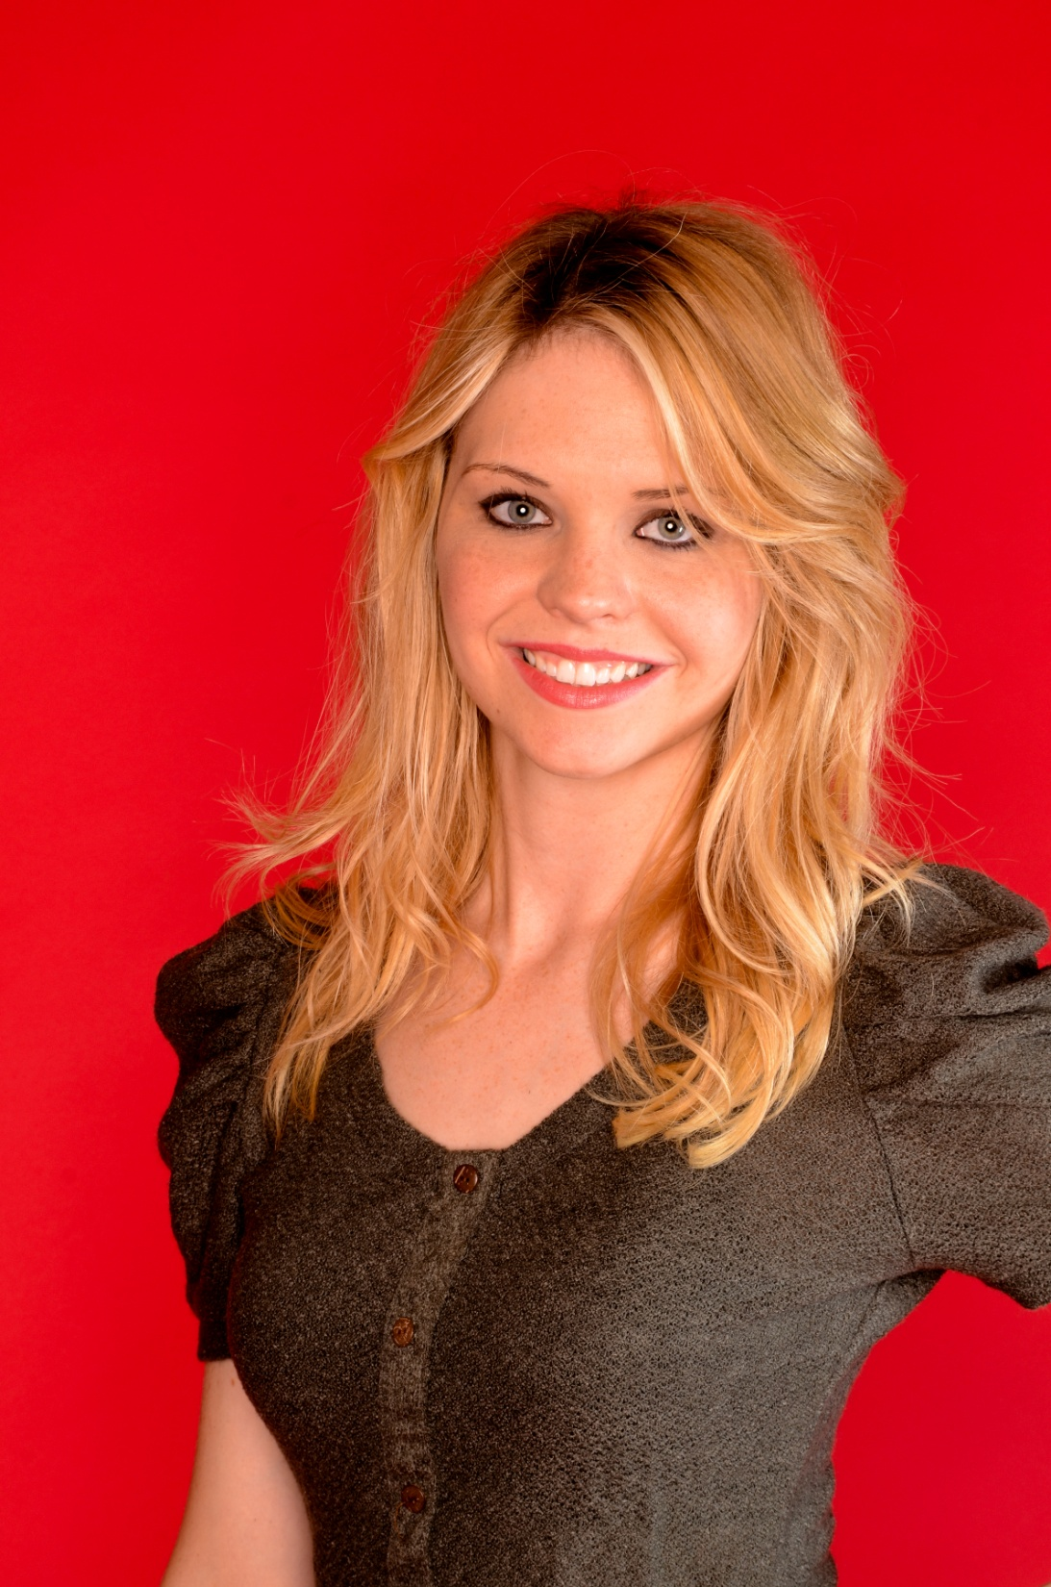

Slide 37
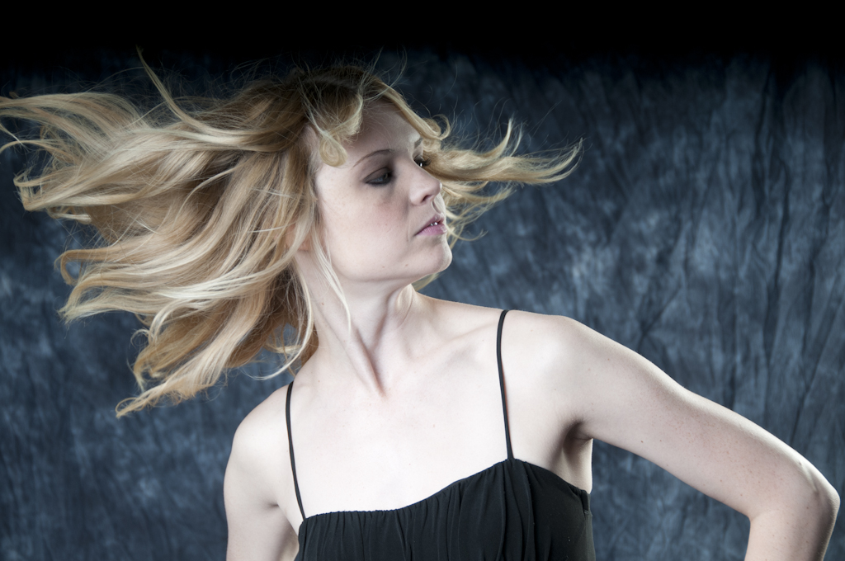

Slide 38
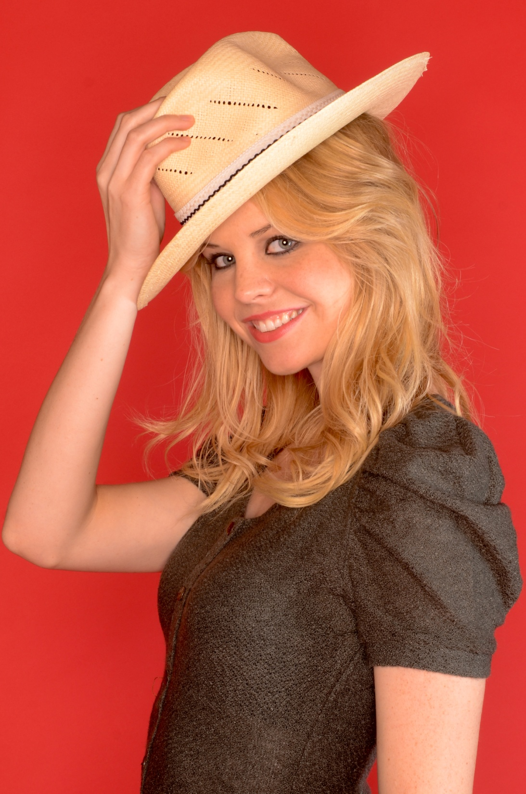

Slide 39
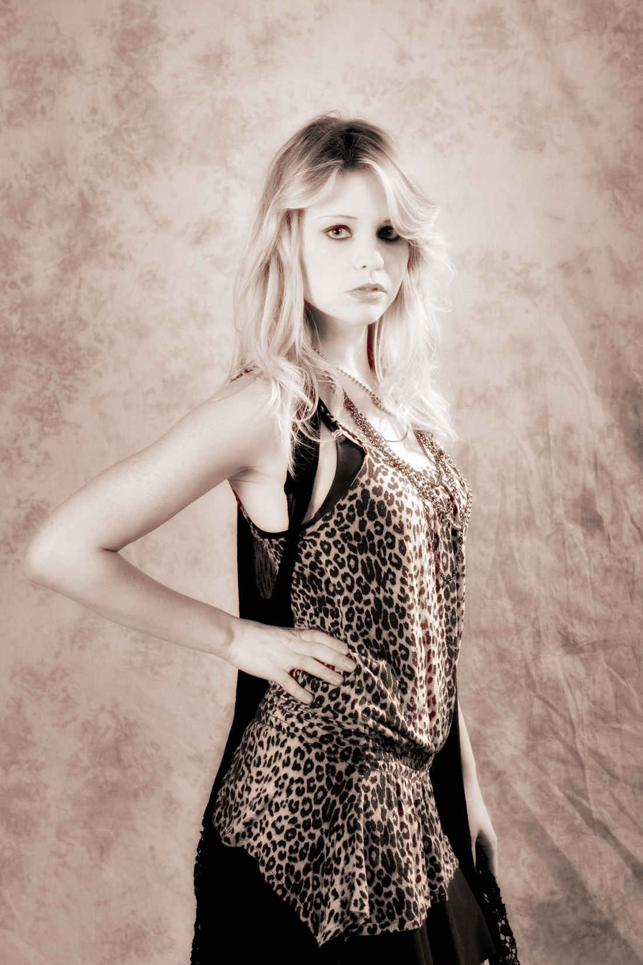

Slide 40
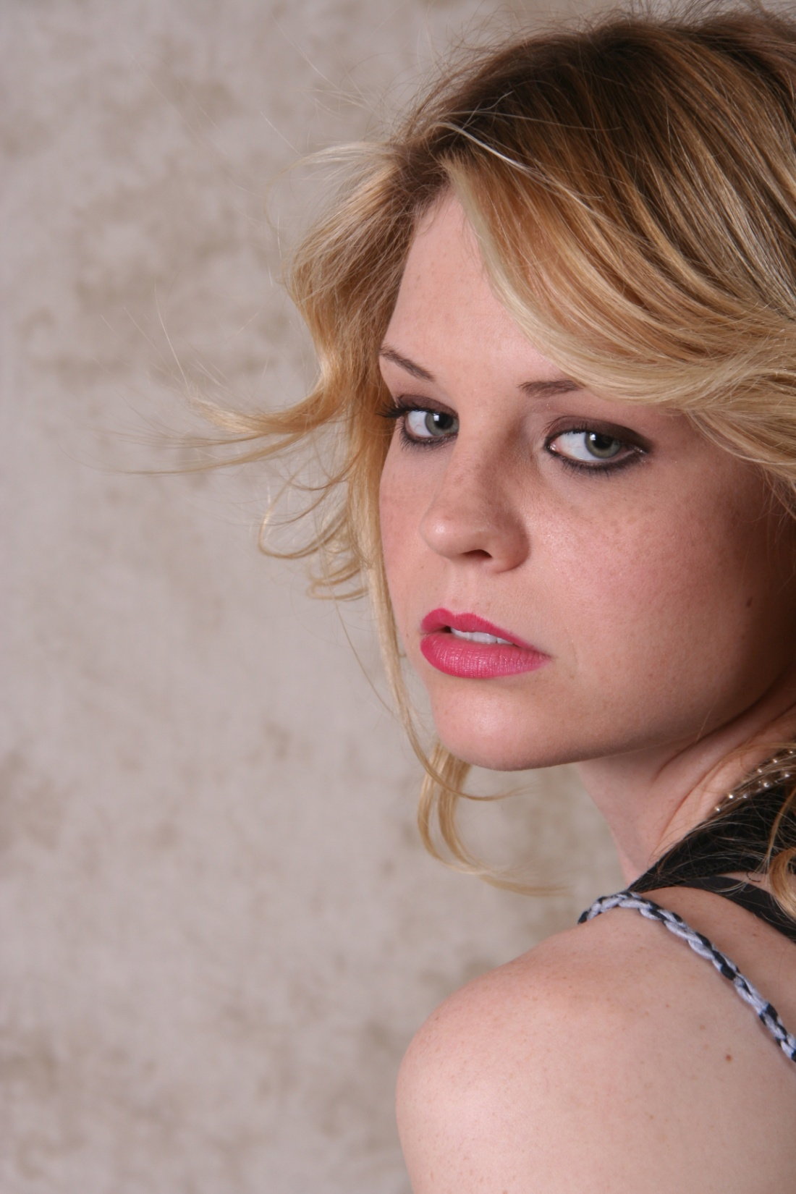

Slide 41


Slide 42
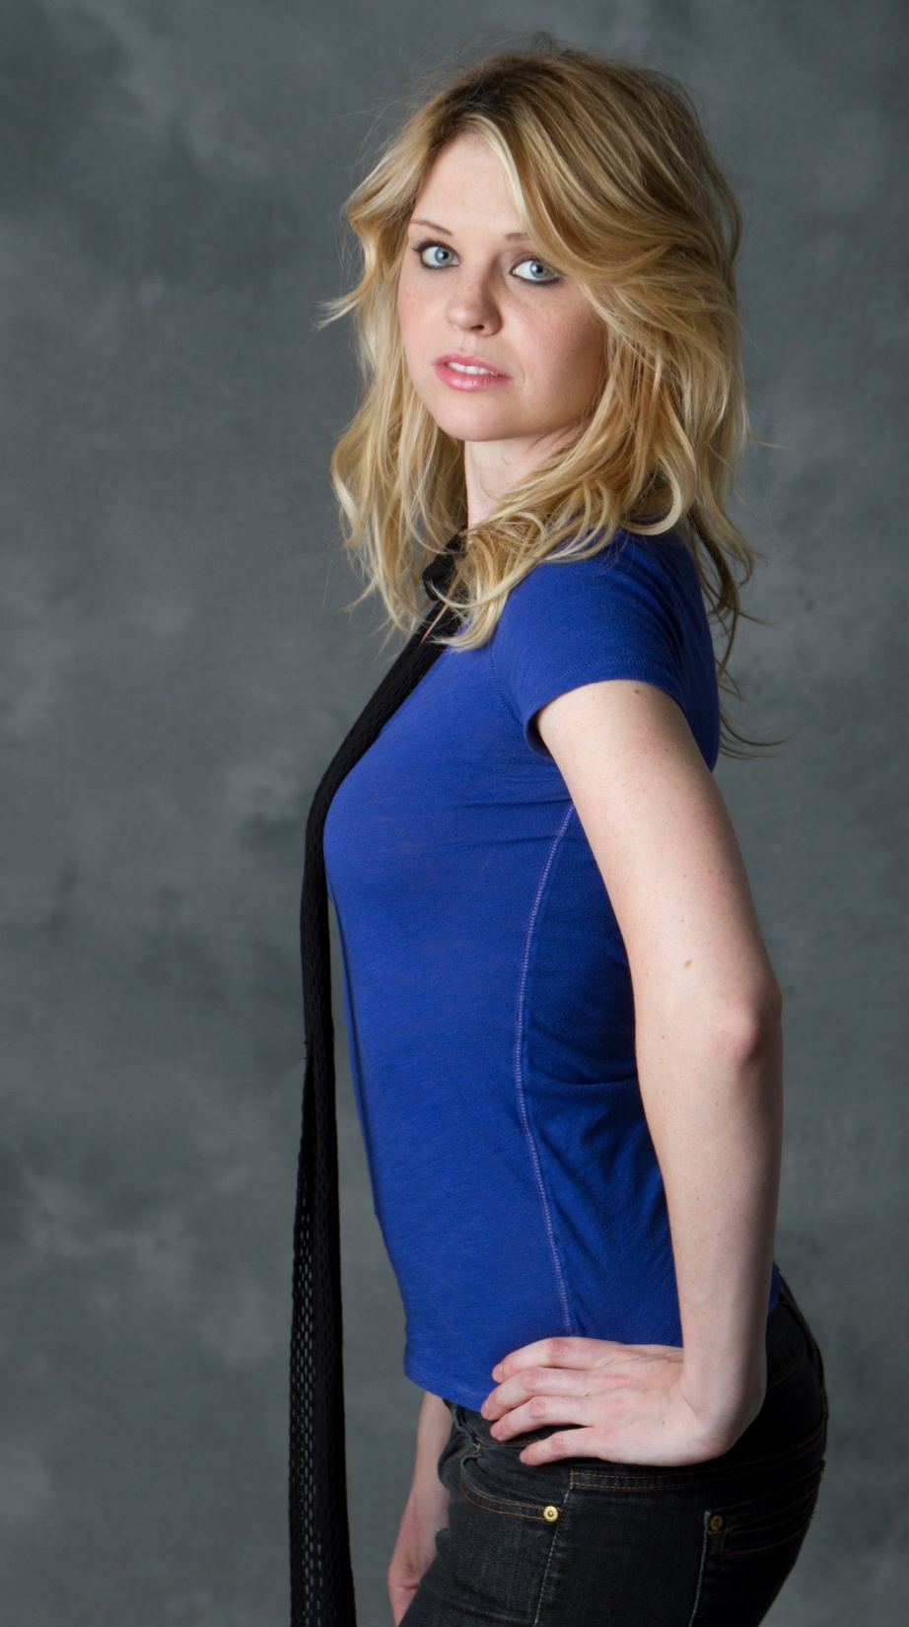

Slide 43
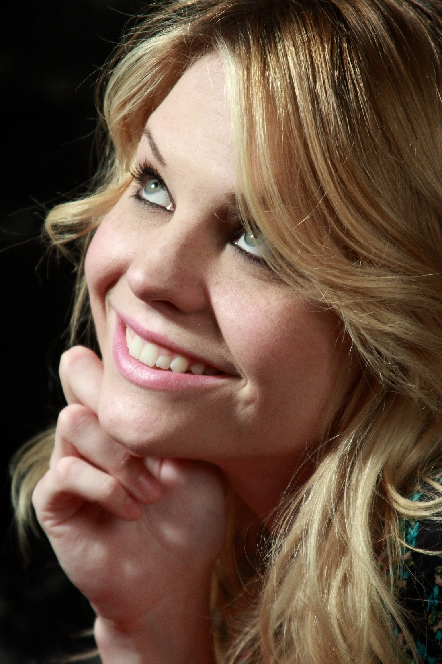

Slide 44
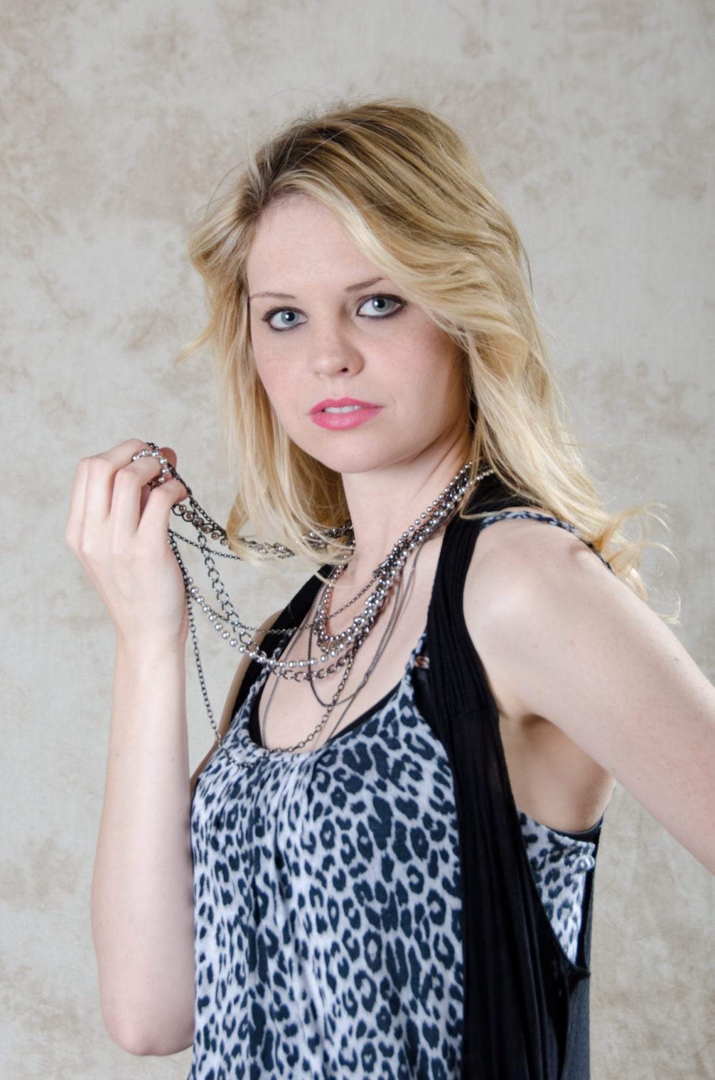

Slide 45
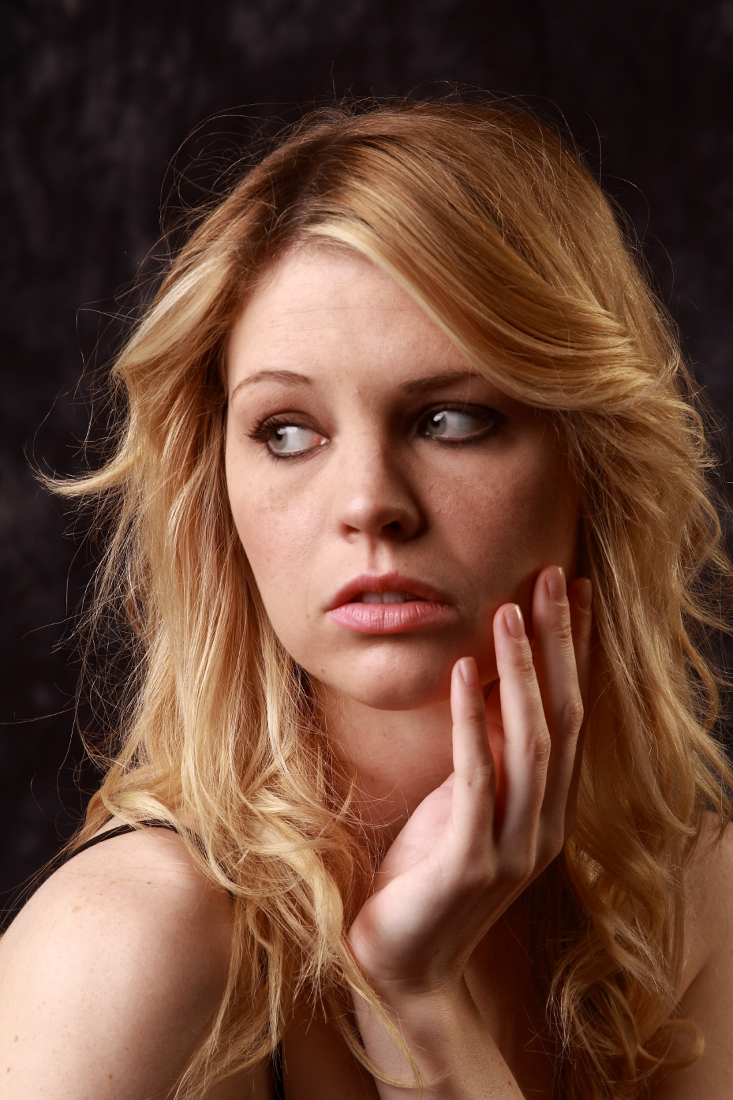

Slide 46
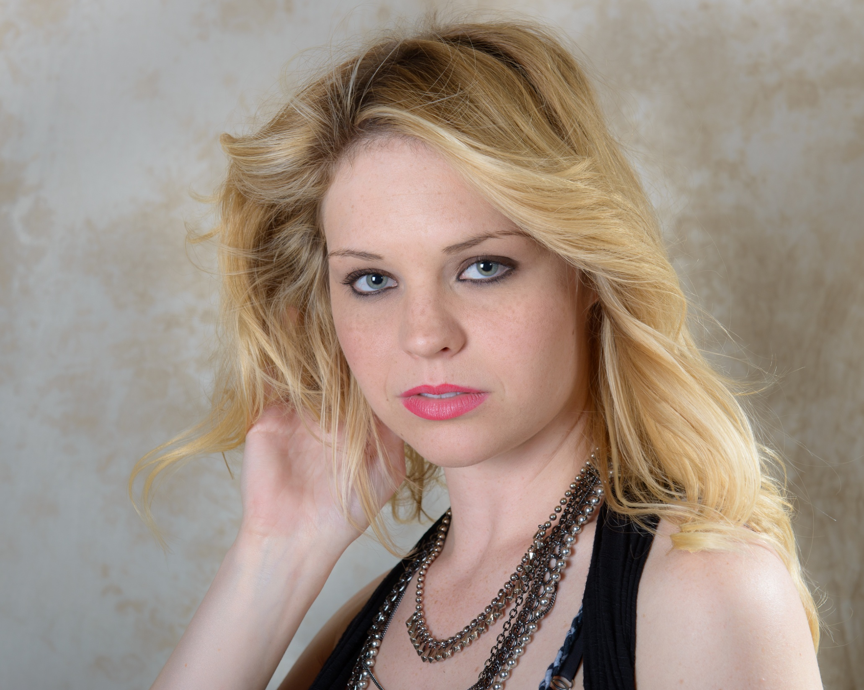

Slide 47
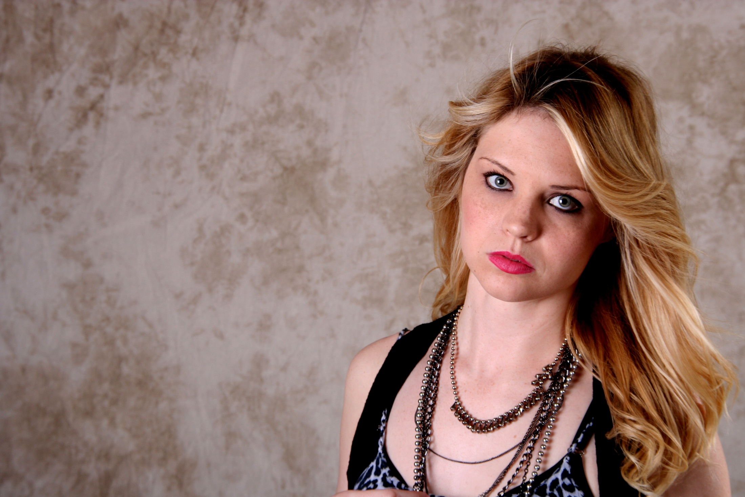

Slide 48
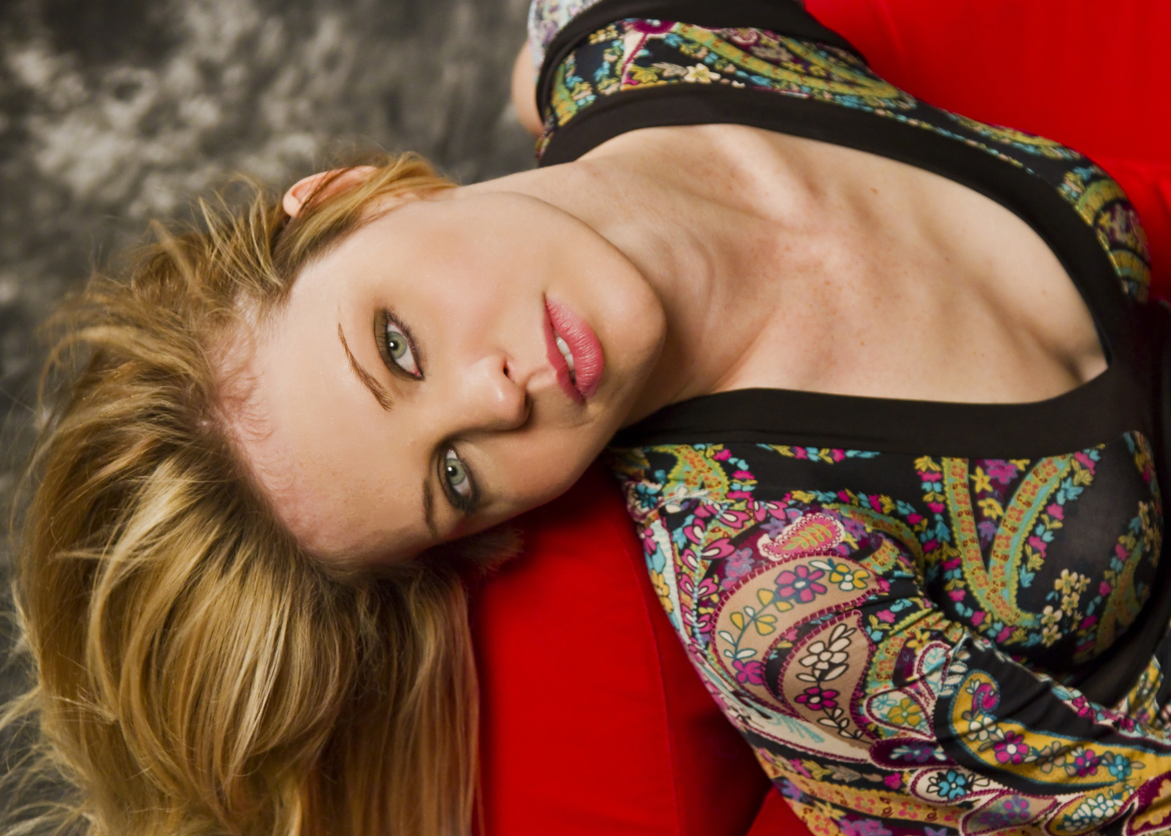

Slide 49
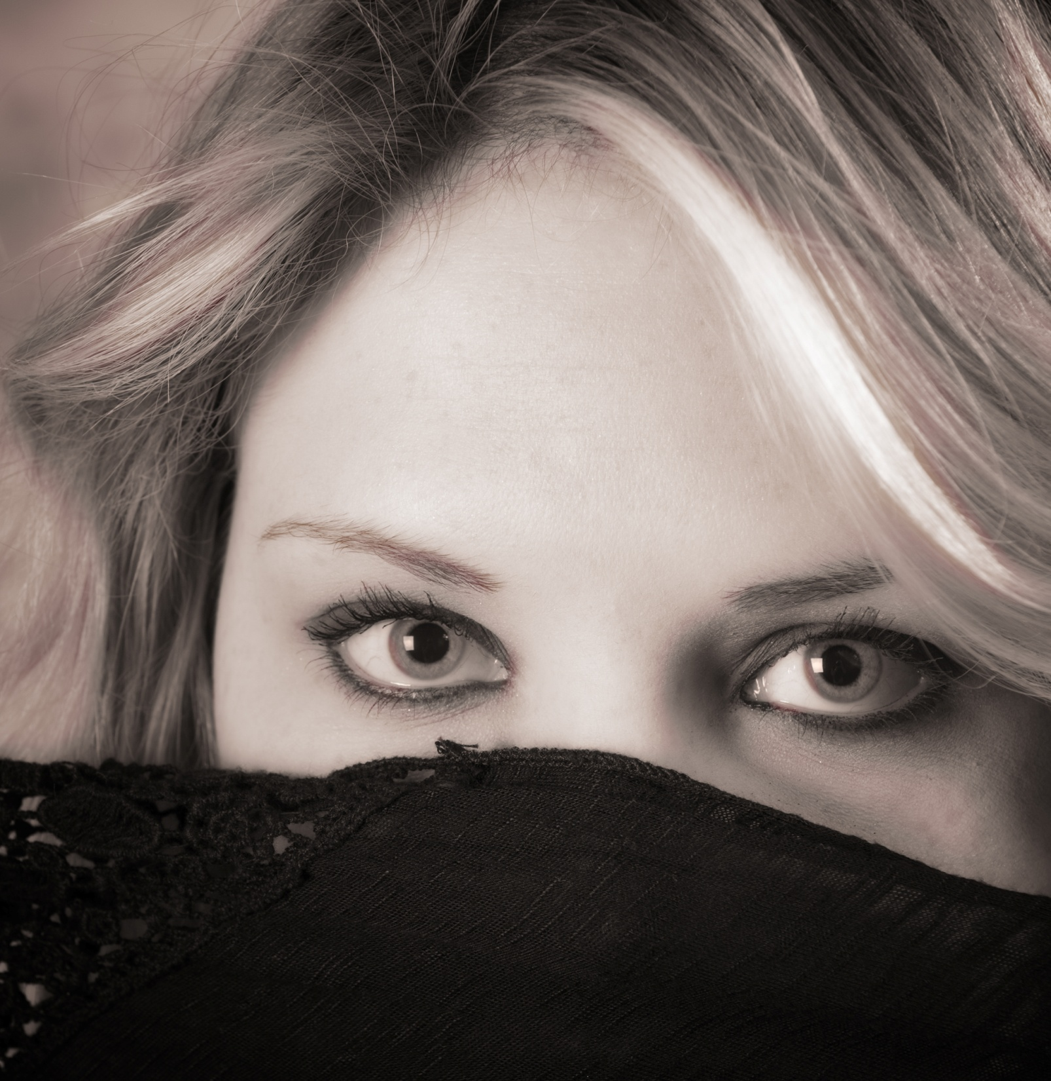

Slide 50

Bekah K.
(7th PPC shoot)
Freelance Model

Slide 51
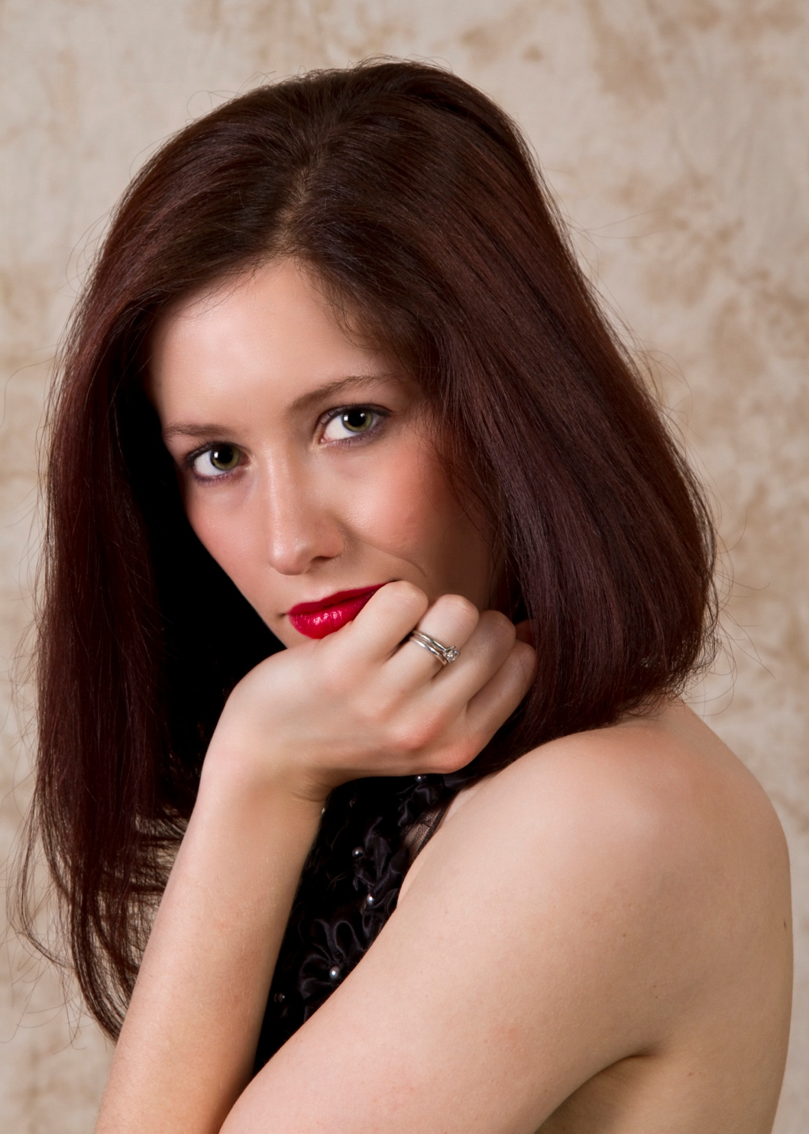

Slide 52
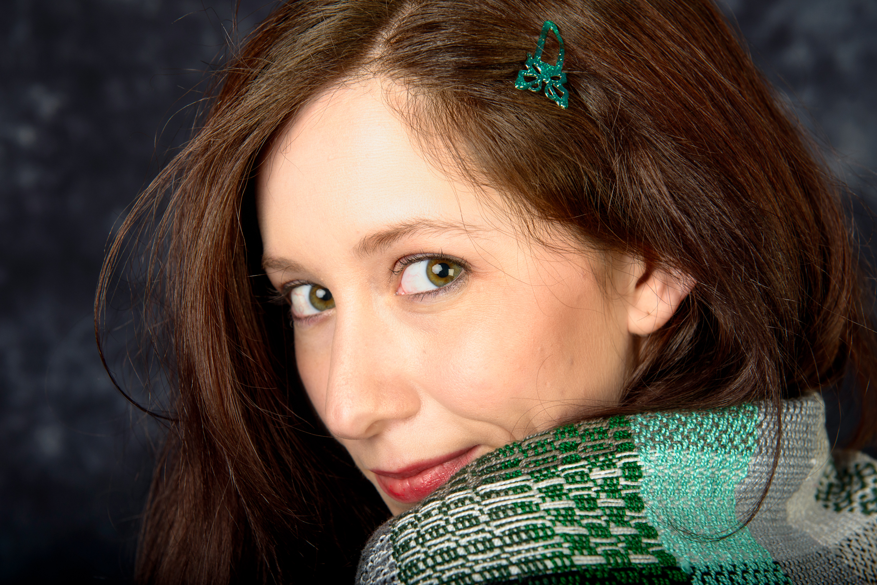

Slide 53
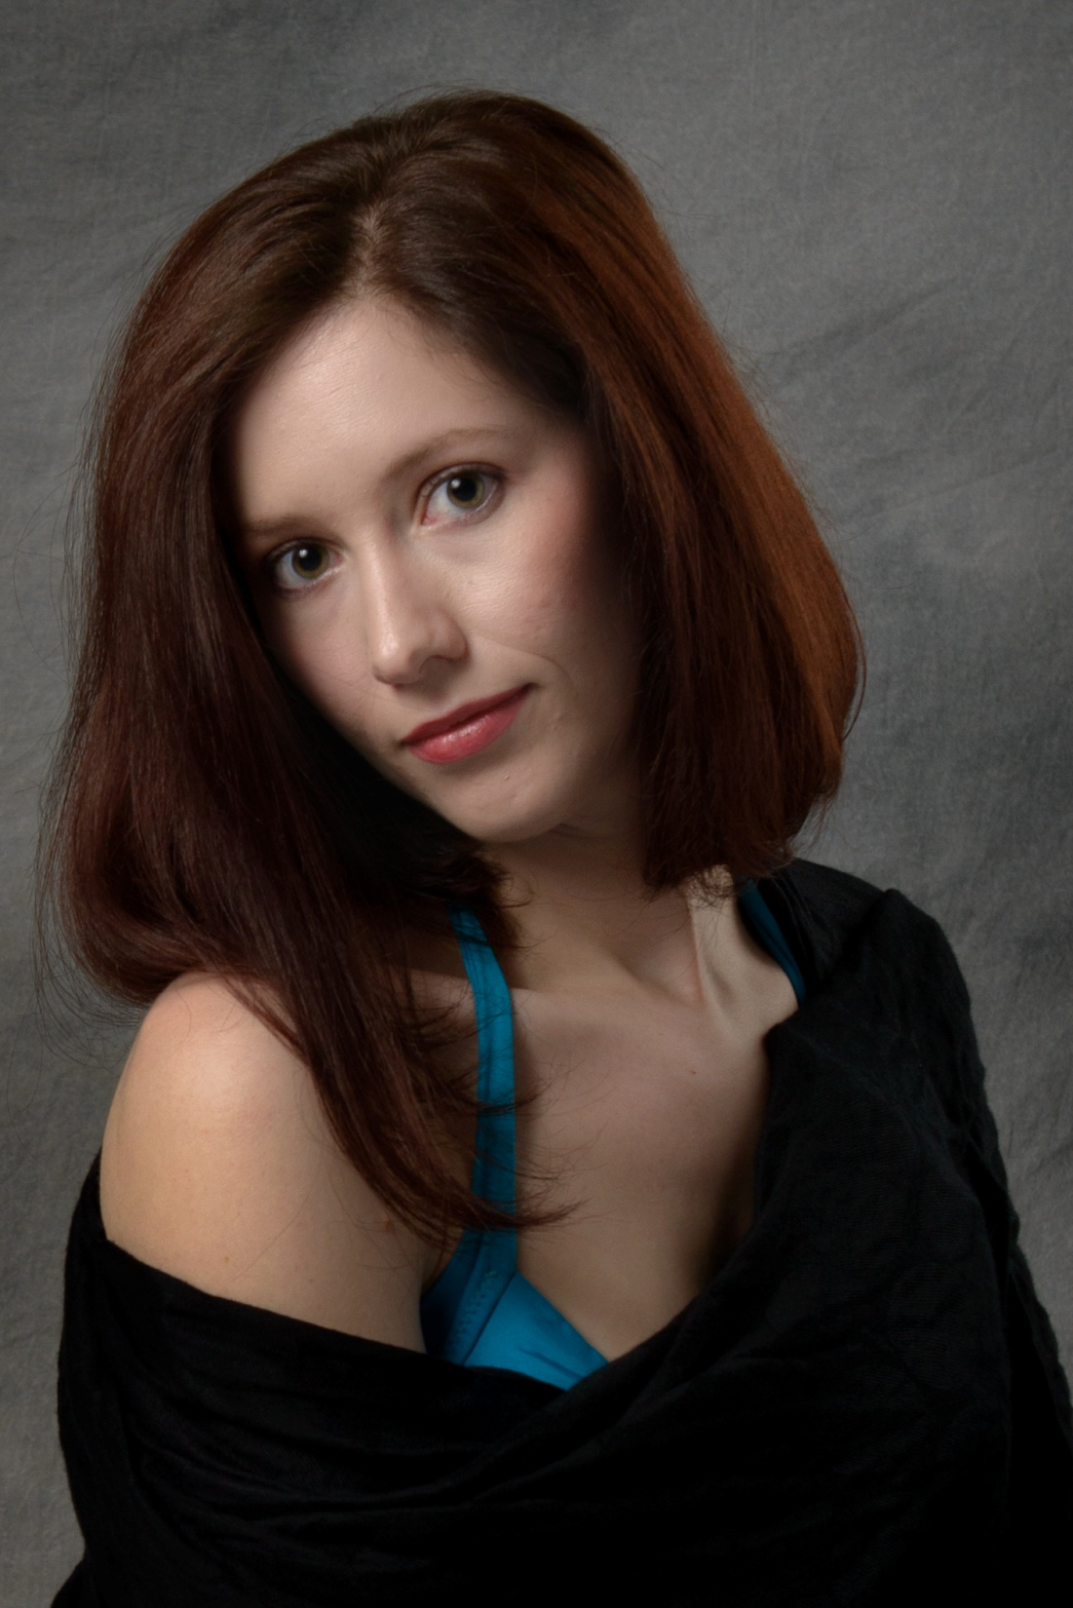

Slide 54
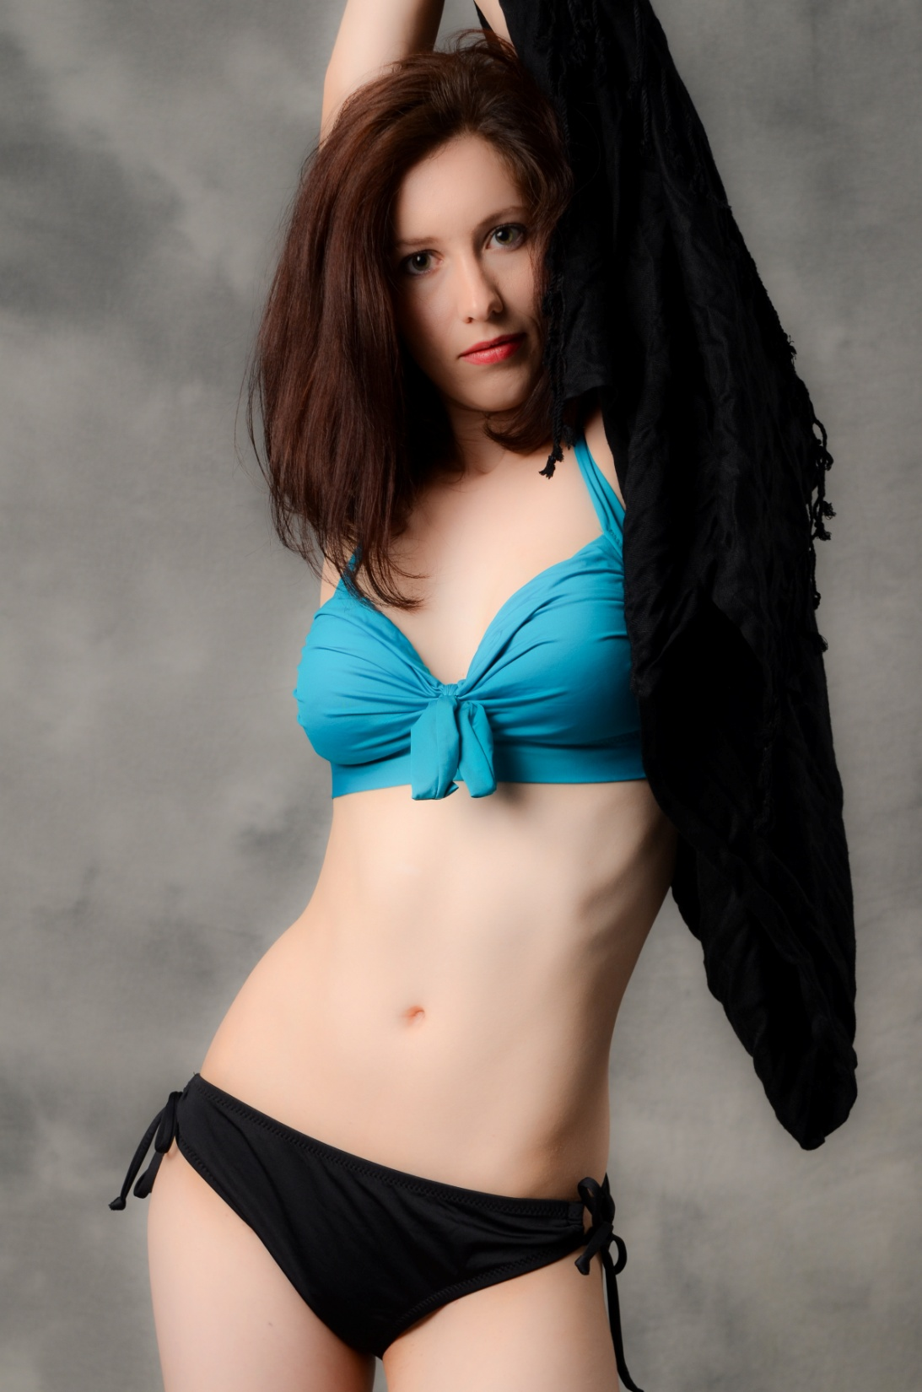

Slide 55
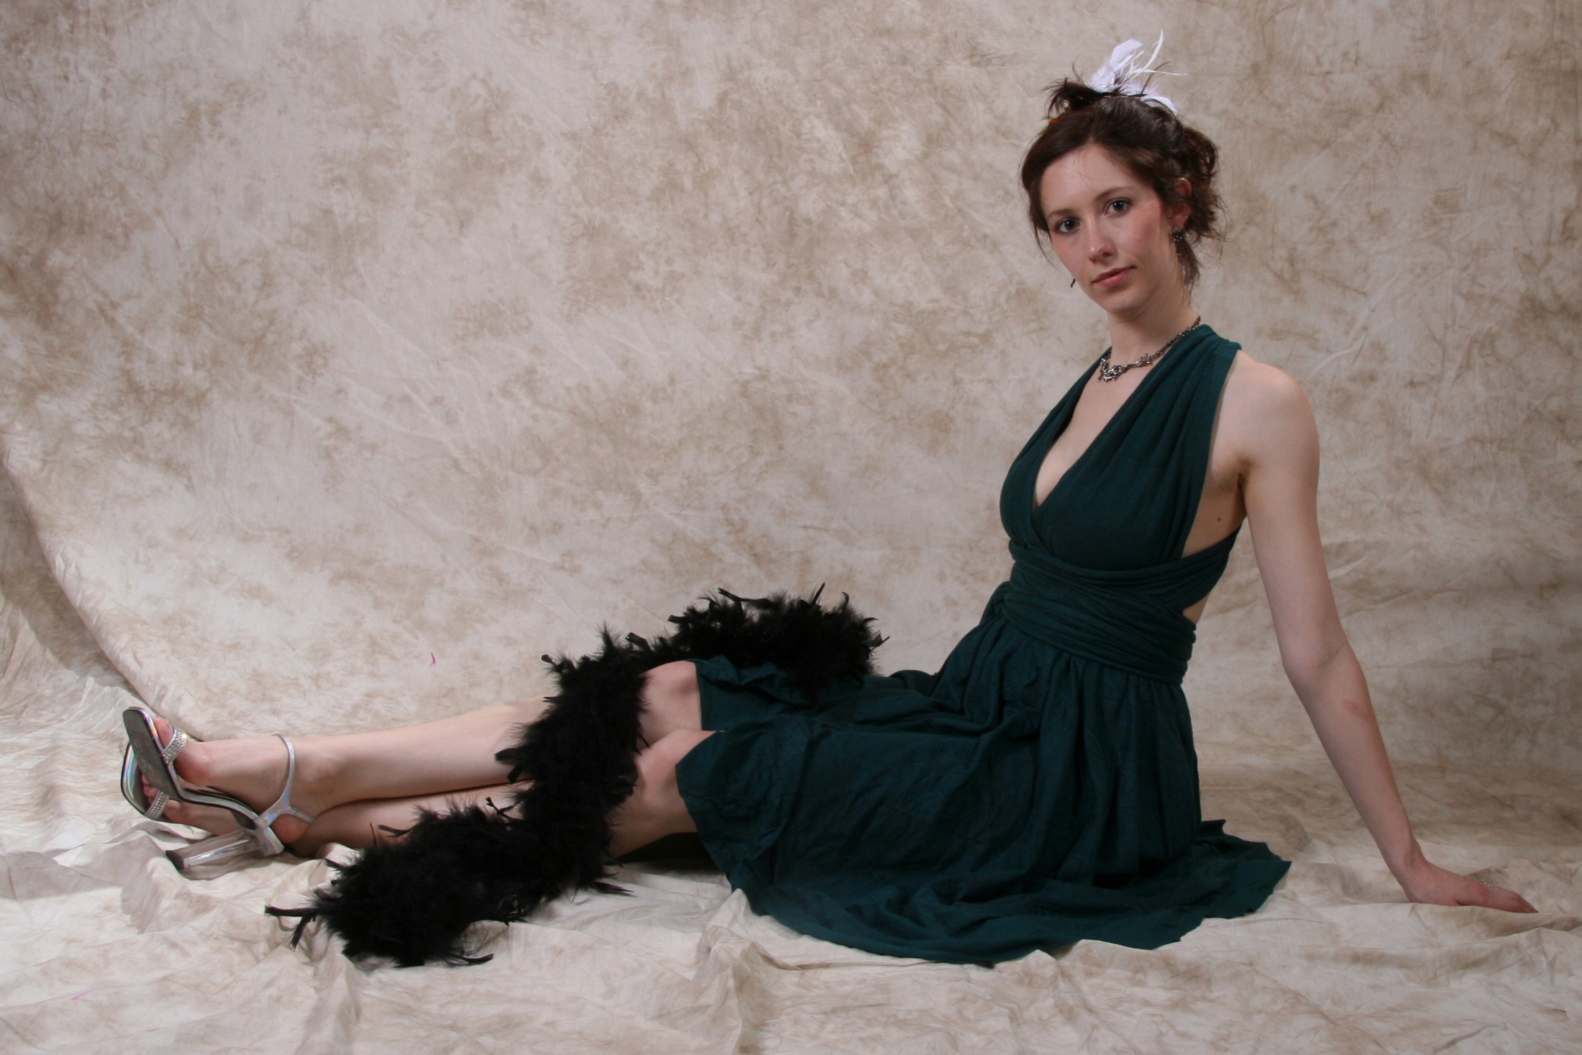

Slide 56
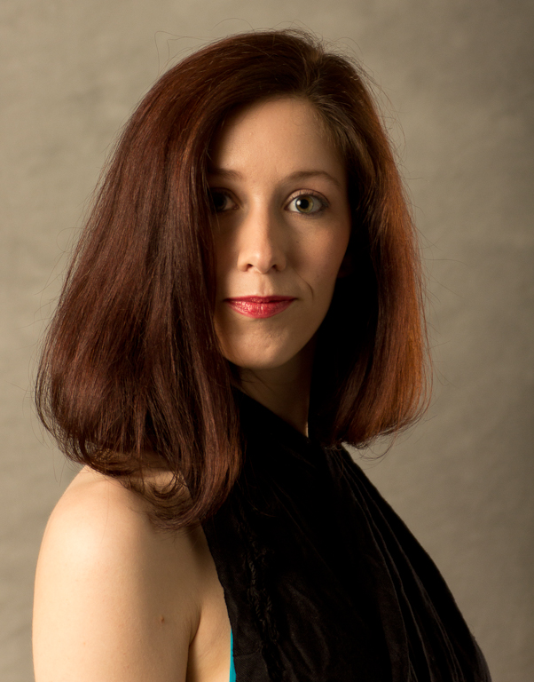

Slide 57


Slide 58


Slide 59


Slide 60


Slide 61


Slide 62


Slide 63


Slide 64


Slide 65


Slide 66
Jamie B.
(1st PPC shoot)
Dawn Rochelle Model Agency
www.DawnRochelle.com

Slide 67


Slide 68


Slide 69


Slide 70


Slide 71


Slide 72


Slide 73


Slide 74


Slide 75


Slide 76


Slide 77


Slide 78


Slide 79


Slide 80


Slide 81


Slide 82
Dawn Rochelle
(2nd PPC shoot)
Dawn Rochelle Model Agency
www.DawnRochelle.com

Slide 83


Slide 84


Slide 85


Slide 86


Slide 87


Slide 88


Slide 89


Slide 90


Slide 91


Slide 92


Slide 93


Slide 94


Slide 95


Slide 96


Slide 97


Slide 98

Thanks to the members providing images for this show:
Dennis Fritsche
Marie Hansen
Patrick Johnson
John Lehman
John Liu
Bud Mallar
Russell McGuire
Saswat Patnaik
Ronnie Scaggs
Jerry Schlesinger
Earl Snoga
Peter Staxen
Ming Yang

Slide 99

Music selections:
[Track # 1] Eyes Like Twins (1990)
Album: Wilson Phillips
Artist: Wilson Phillips
[Track # 2] The Dream is Still Alive (1990)
Album: Wilson Phillips
Artist: Wilson Phillips

Slide 100
Show produced by PPC member:
Ken Guthrie
© 2012 PPC

Slide 101
The End

